Slide 1

FeedForward Neural Networks
Course 3, Module 3, Lesson 1

Slide 2
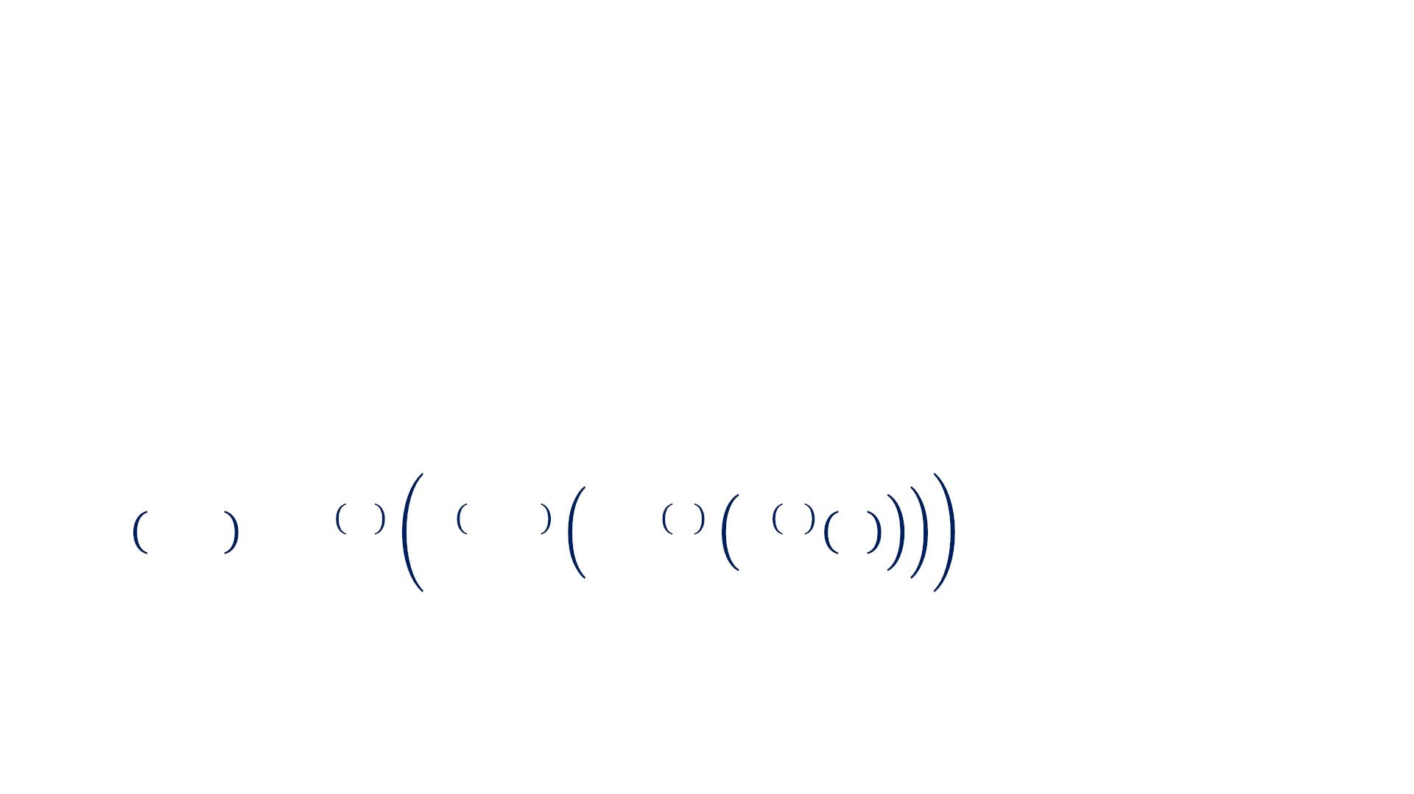
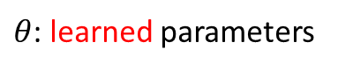
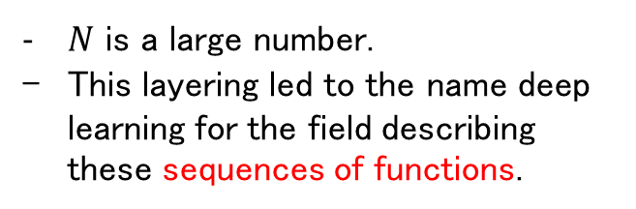
Feedforward Neural Networks
The concept of learned parameters is important, as we do not start with the correct form of the function , which maps the inputs to outputs directly.
This means that neural networks can be thought of as function approximators.（target functionになるべく近似する）
• A Feedforward Neural Network defines a mapping
from input ! to output " as:
' = !("; $)
$θ$: learned parameters
• An N layer FNN is represented as the function
composition（関数合成）:
$N$ is a large number.
This layering led to the name deep learning for the field describing these sequences of functions.
! "; $ = ! ! !
!"#
$
#
… ! ! "

Slide 3
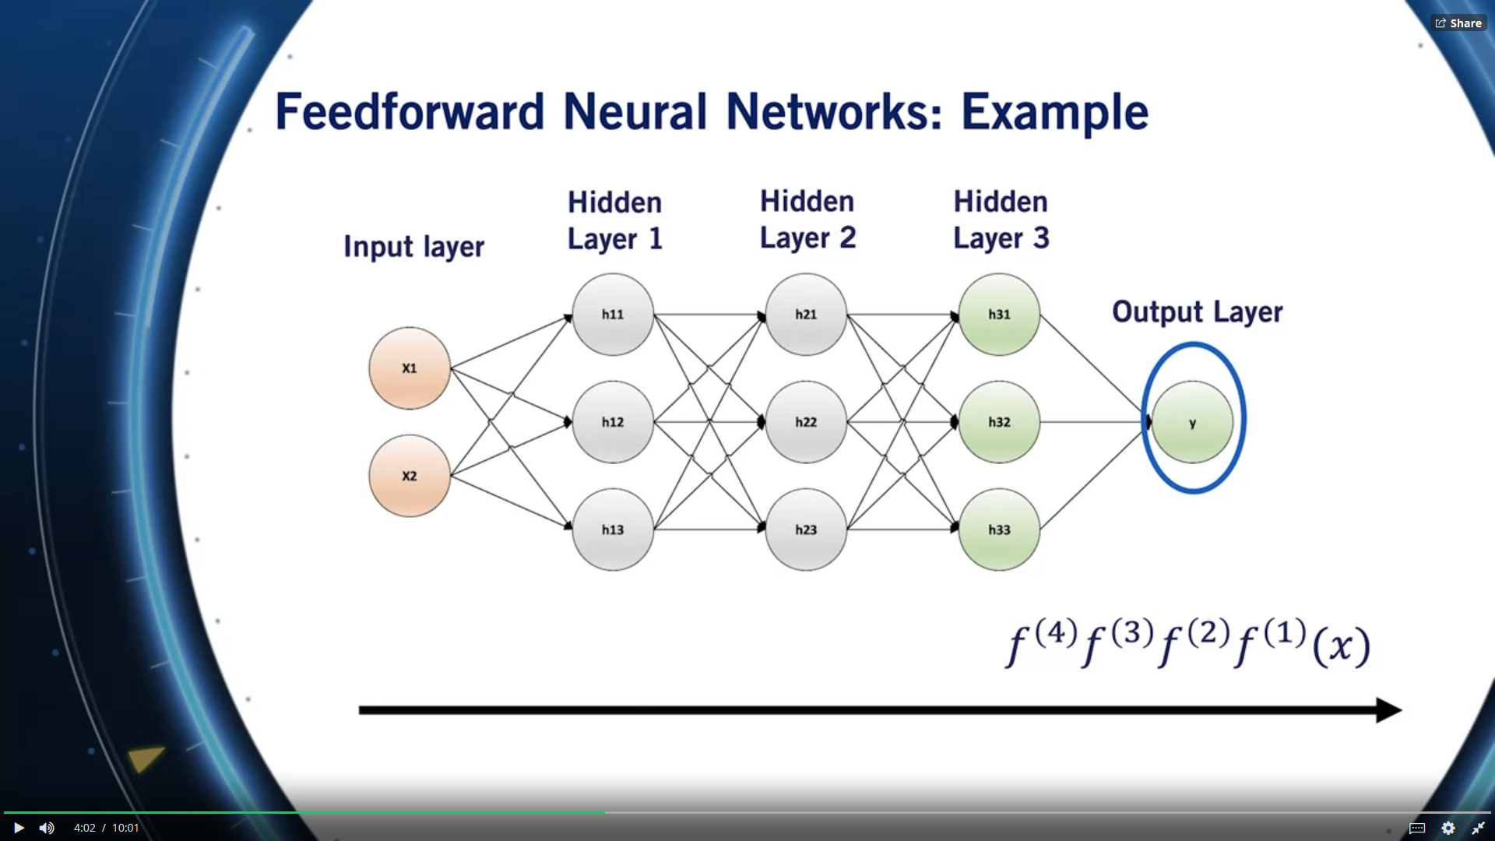
Feedforward: This is because information flows from the input x through some intermediate steps, all the way to the output y without any feedback connections.
- The terms are used in the same way when describing control for self-driving cars.

Slide 4
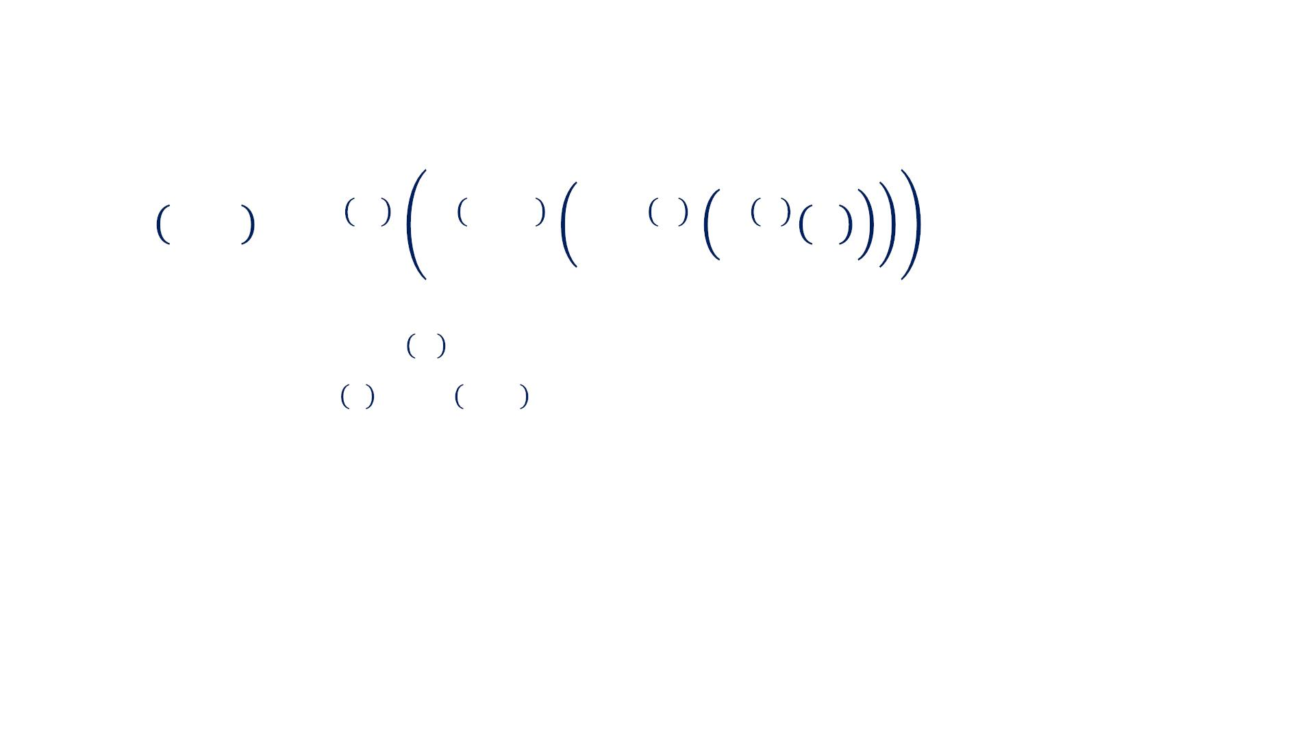
Feedforward Neural Networks
! "; $ = ! ! !
!"#
$
#
… ! ! "
• ! is called the input layer
• The final function " # is called the output layer
$
#%$
• The functions " to " are called the hidden layers

Slide 5
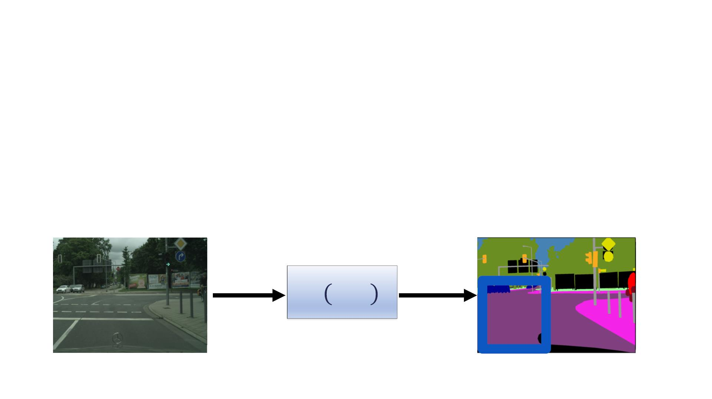
Feedforward Neural Networks
This flexibility to represent hard-to-model processes is what makes neural networks so popular.
• Functions to estimate:
o Object Classification: Image à Label
o Object Detection: Image à Label + Location
o Depth Estimation: Image à Depth for every pixel
o Semantic Segmentation: Image à Label for every pixel
&'(
!
ꢀ
" !; $
!%"#

Slide 6
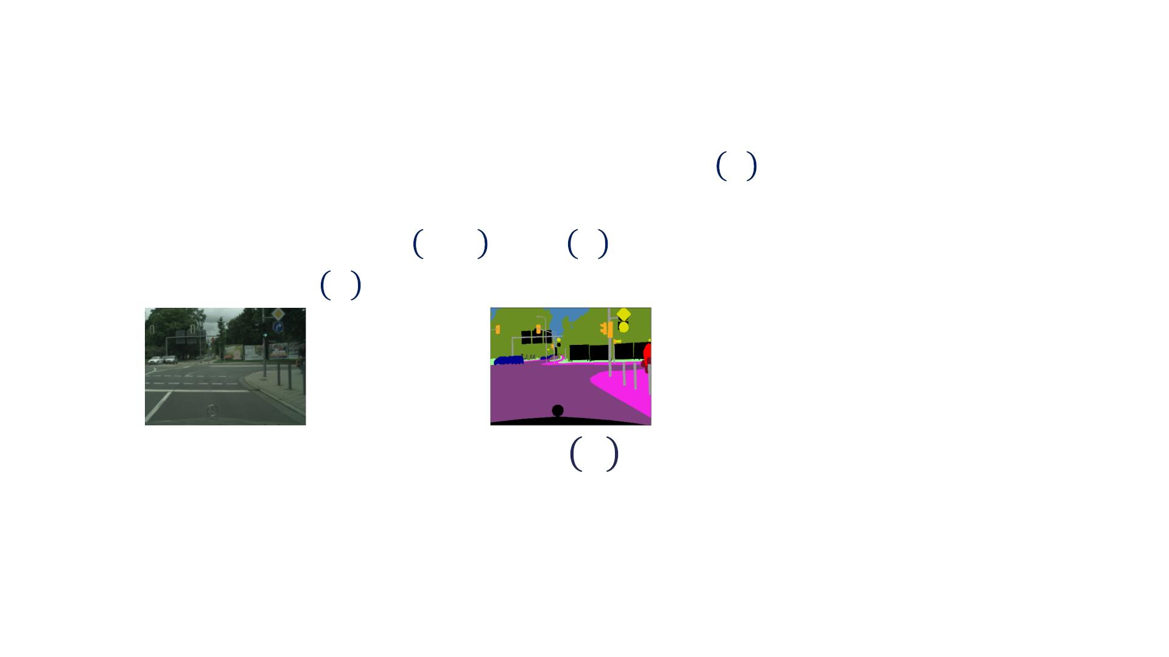
Mode Of Action Of Neural Networks
• Training: Give neural network examples of !∗ # . for
a wide variation of the input #. Then, optimize its
parameters % to force ! #; % ≅ !∗ #
• Pairs of # and !∗ # are called training data
"∗ !
!
• Only output is specified by training data! Network is
free to do anything with its hidden layers

Slide 7
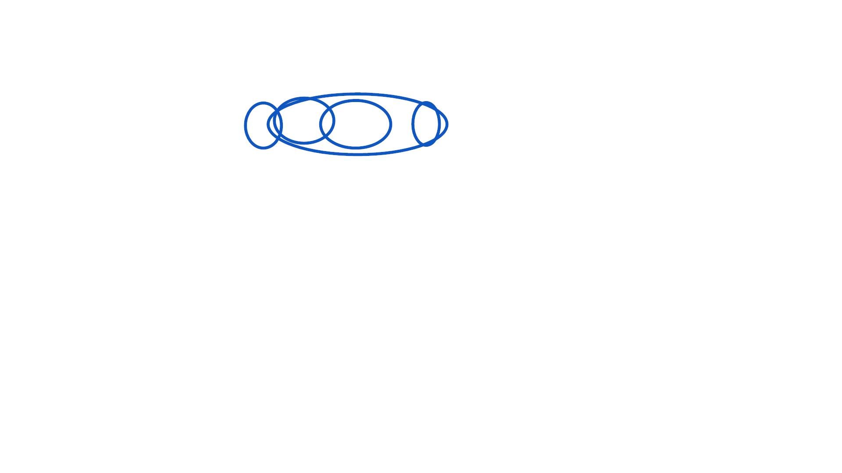
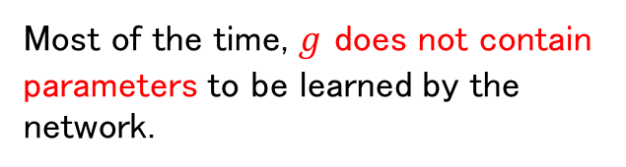
Hidden Units
"
ℎ = #(% ℎ + ')
!
!#$
• Activation function !
• Input ℎ#$%
• Weight matrix &
• Bias '
• Parameters ( are the weights and biases of all the
layers of the network
• Transformed parameters passed through activation
function !
element-wise non-linear function.
Most of the time, $g$ does not contain parameters to be learned by the network.

Slide 8
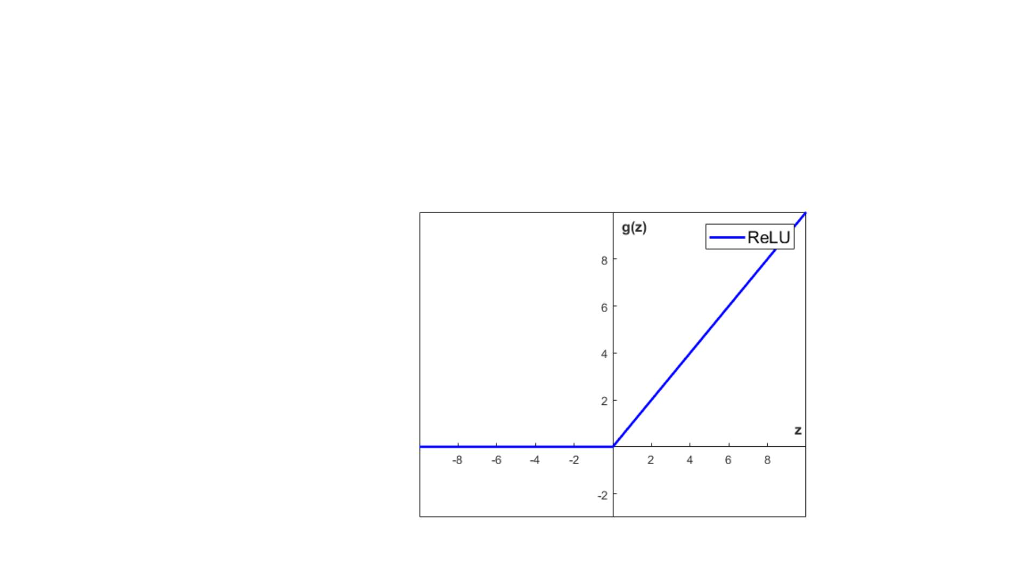
The Rectified Linear Unit: ReLU
• The ReLU hidden unit is currently the default choice
of activation function for Feedforward Neural
Networks
!(#) = &'((), #)
Since they are very similar to linear units, they’re quite easy to optimize.

Slide 9
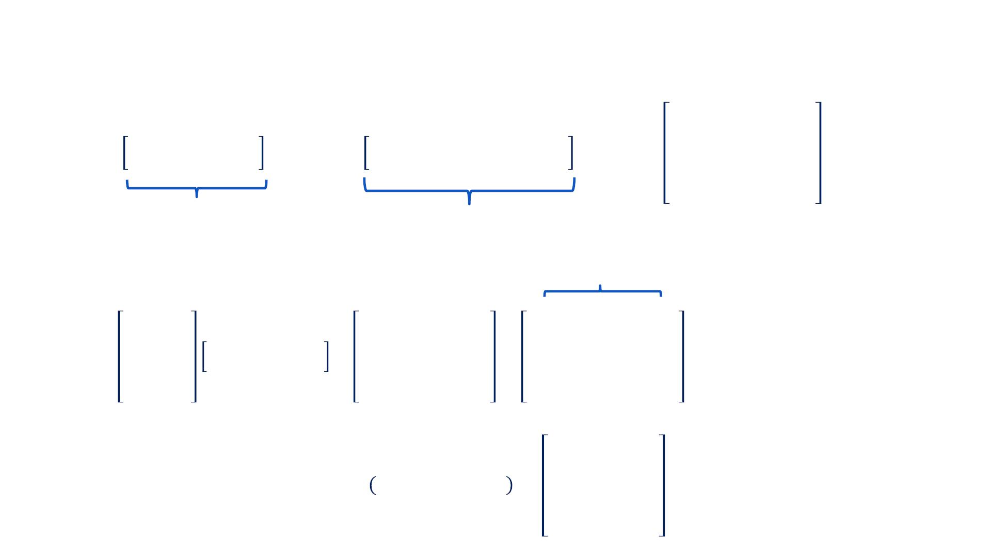
Example: Hidden Layer With RELU Activation
Function
−2 −18 −12
−6 −3
. = −7 4
2
−9
ℎ!"#
=
−17 12 −6
−14 2 7
,
* =
9 −2 9 10 −3
−3 10 4 6 3
,
−6 −12 −10
−8 4 −15
!×#
!×$
$
$×#
Evaluate affine transformation * ℎ + .:
!"#
9 −3
−2 10
−2 −18 −12
−6 −3
+ −7
−113 84 −87
−112 −7 84
−9 = −216 120 −35
−6 −12 −10 −260 120 −28
−26 24
−17 12 −6
−14 2
2
9
4
7
4
10 6
−3 3
−8
4
−15
1
0 84 0
0 0 84
ℎ = max 0, * ℎ + . = 0 120 0
$
!
!"#
0 120 0
1 0 24

Slide 10
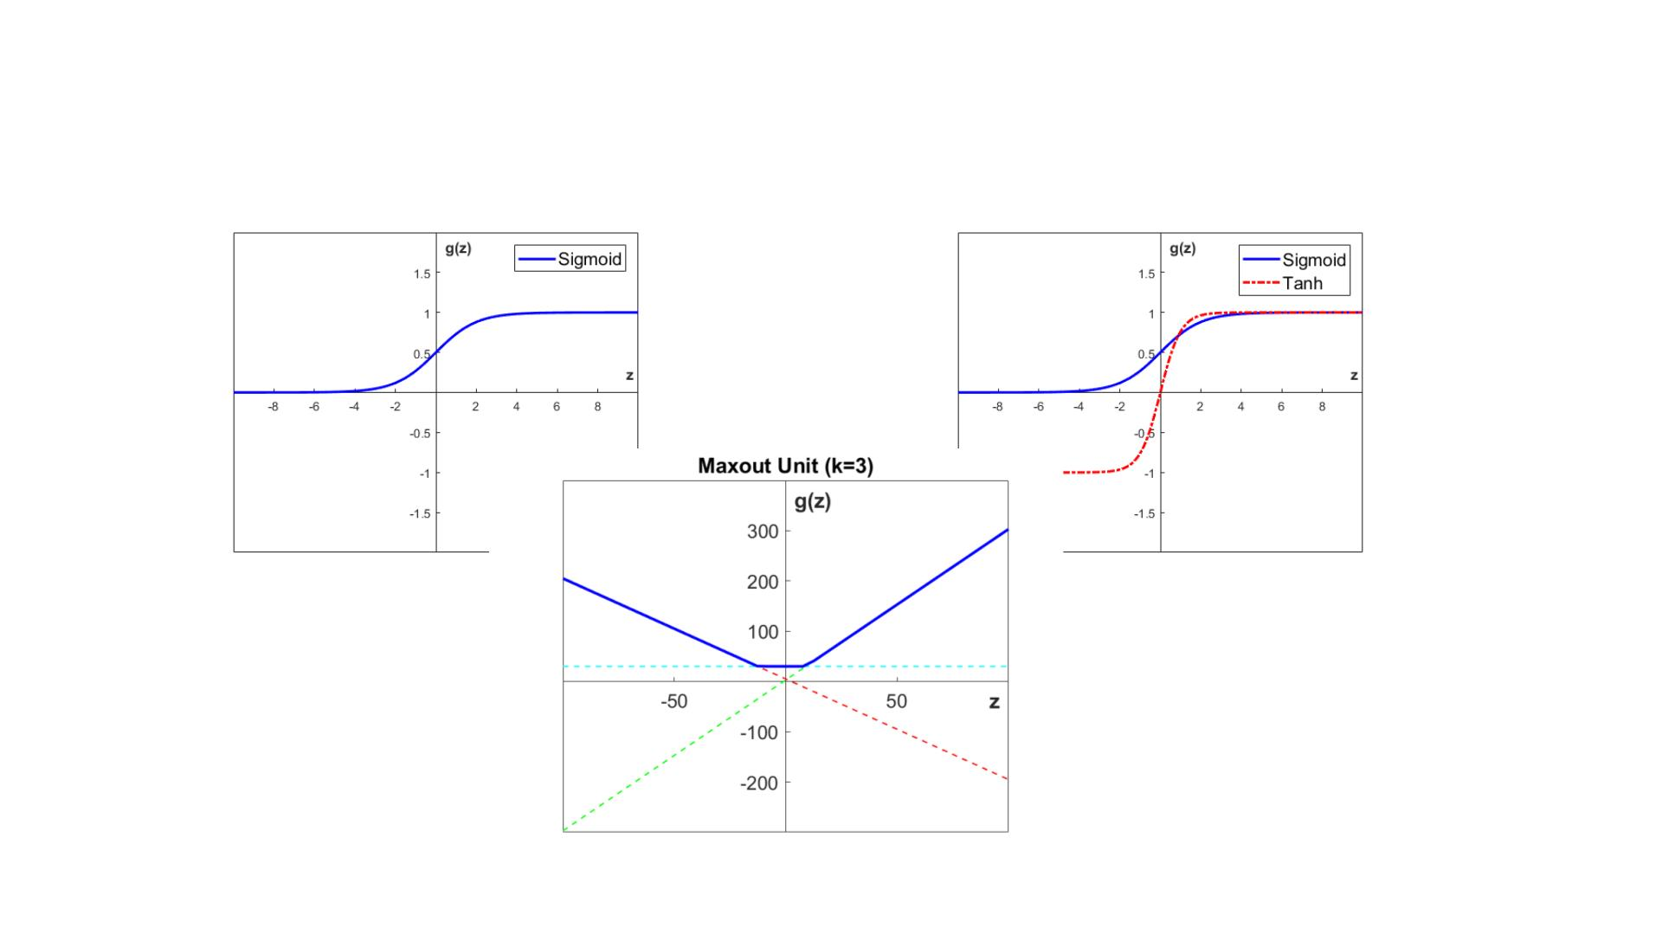
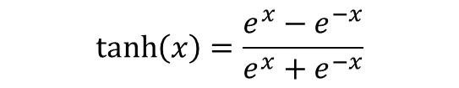
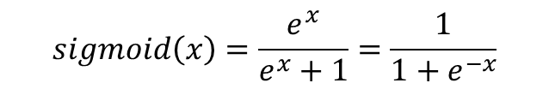
Activation Functions
$$\tanh\left(x\right)=\frac{{e^{x}−e}^{−x}}{e^{x}+e^{−x}}$$
$$sigmoid\left(x\right)=\frac{e^{x}}{e^{x}+1}=\frac{1}{1+e^{−x}}$$
the hyperbolic(双曲線) tangent non-linearity
the generalization of ReLU: the mahout non-linearity.

Slide 11

Summary
• Feedforward neural networks can be used for a
variety of perception tasks related to self-driving
cars
• Feedforward neural networks rely on hidden layers to
implement a good approximation of a target function
• Various activation functions are available to use
within hidden layers. RELU is the default baseline
• Next: Output Layers and Loss Functions

Slide 12

Output Layers and Loss Functions
Course 3, Module 3, Lesson 2

Slide 13
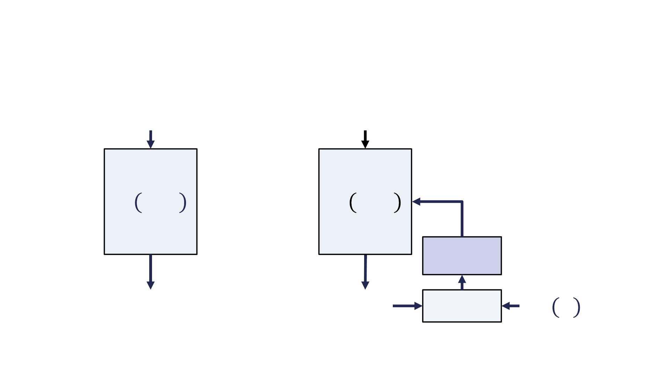
Generally, supervised machine learning models including neural networks have two modes of operation, inference and training.
Inference is usually the operation we used when we deploy the machine learning algorithms in the real world.
For self-driving, the training data often takes the form of human annotated images which take a long time to produce.
The Optimization procedure takes in the output of the loss function and provides a new set of parameters that provide a lower value for that loss function.
Machine Learning Algorithm Design
"
"
! "; $
! "; $
Optimization
%
%
!∗ "
Loss Function

Slide 14
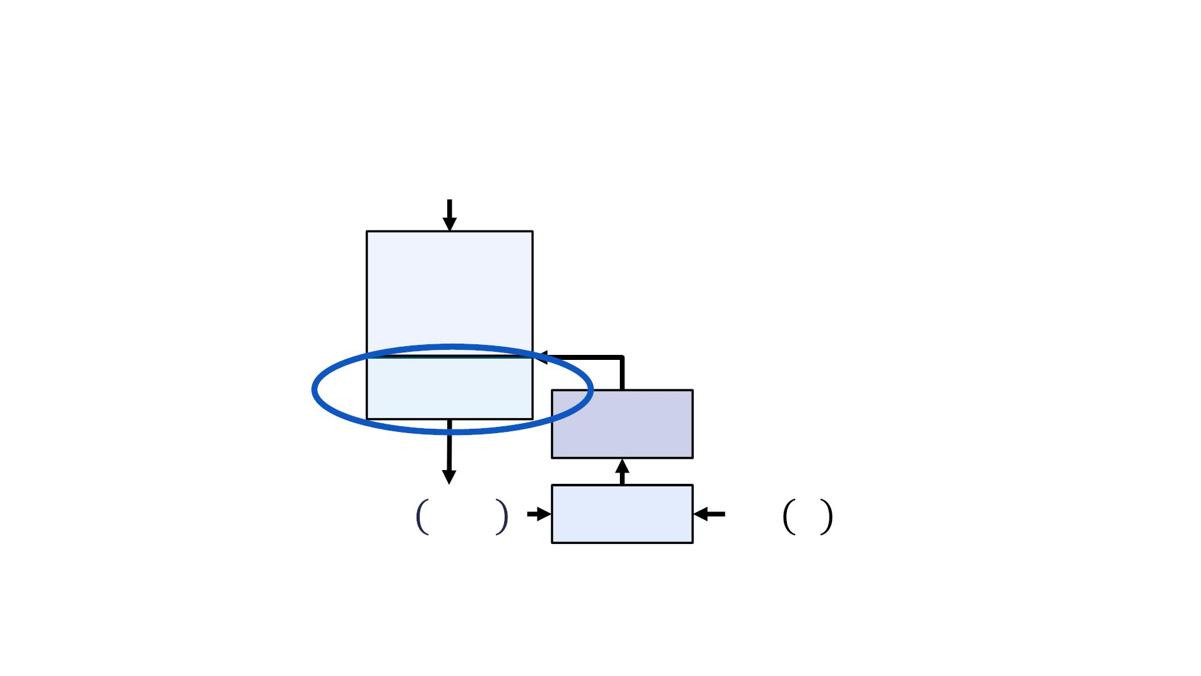
Artificial Neural Networks
$
Hidden
Layers
Output Layer
Optimization
! = # $; &
#∗ $
Loss Function
The major difference between the design of traditional machine learning algorithms and the design of artificial neural networks, is that the neural network only interacts with the loss function via the output layer.
- Therefore, it is quite reasonable that the output layer and the loss function are designed together depending on the task at hand.

Slide 15
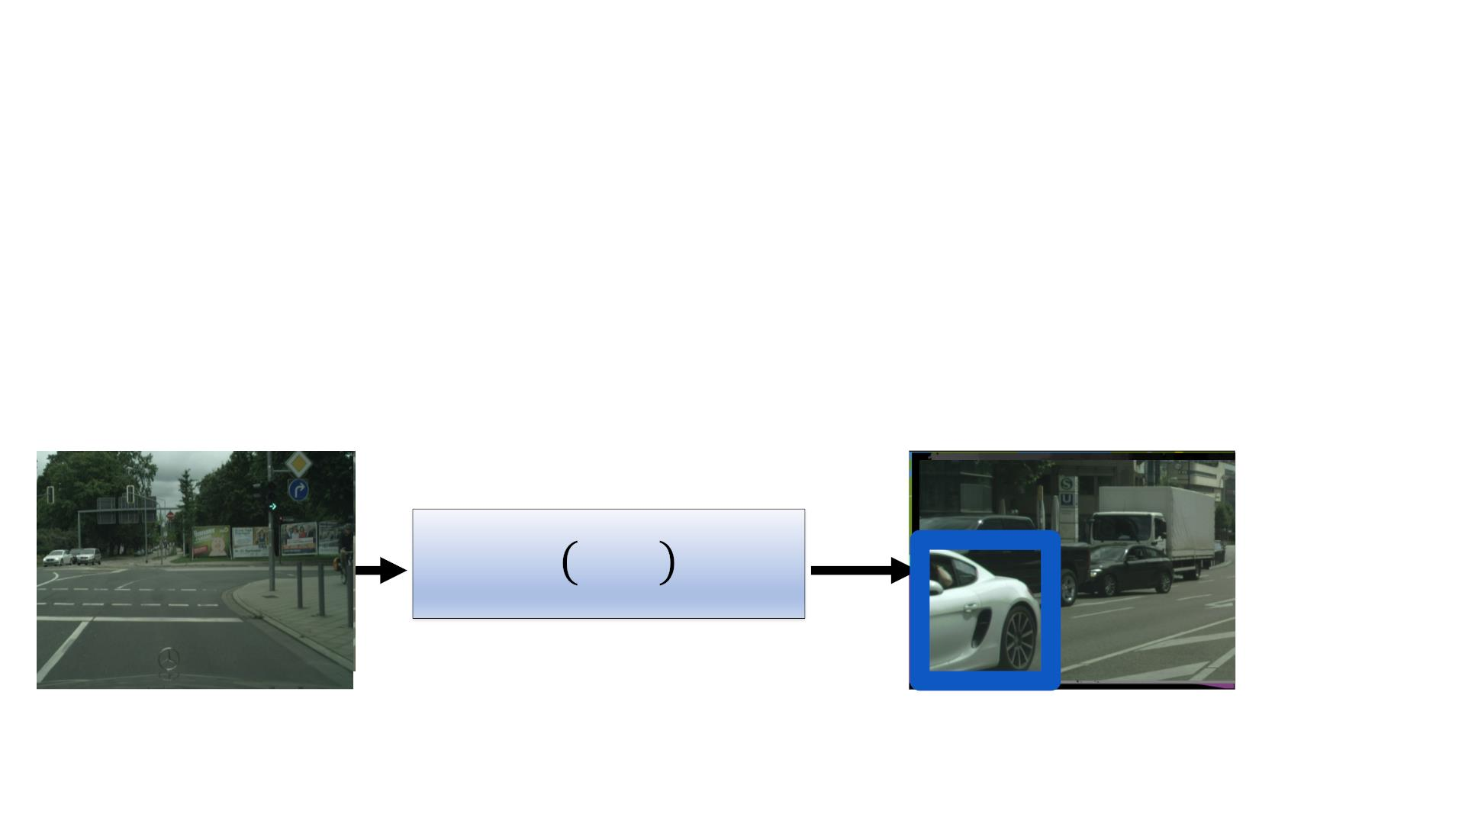
Tasks: Classification and Regression（回帰「かいき」）
• Classification: Given input ! map it to one of "
classes or categories.
o Image classification, semantic segmentation
• Regression: Given input ! map it to a real number
o Depth prediction, bounding box estimation
%&'
ꢀ
! "; $

Slide 16
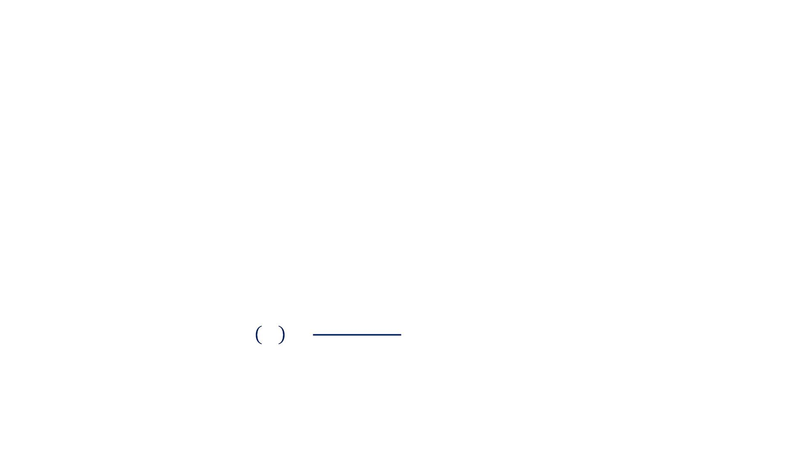
Classification: Softmax Output Layers
• Softmax output layers are most often used as the
output of a classifier, to represent the probability
distribution over ! different classes
• The Softmax output layer is comprised of:
o A linear transformation:
# = %&ℎ + )
o Followed by the Softmax function:
exp(#₁)
*+,-./0 #₁ =
∑ exp(# )
8
8

Slide 17
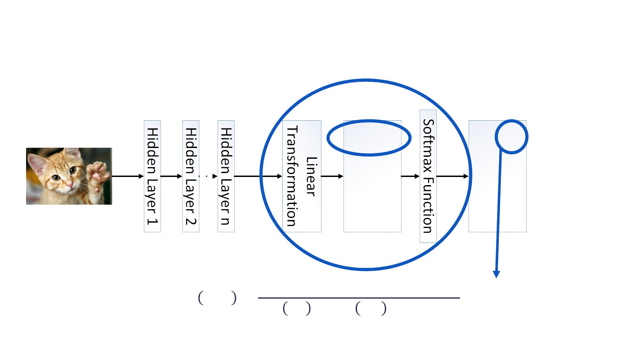
Classification: Softmax Output Layers
Cat
Dog
Fox
13
-7
Cat
Dog
Fox
0.88
1e-9
11
0.119
exp(13)
exp 13 + exp −7 + exp(11)
!"#$%&' ℎ_{)*+} =
= 0.88

Slide 18
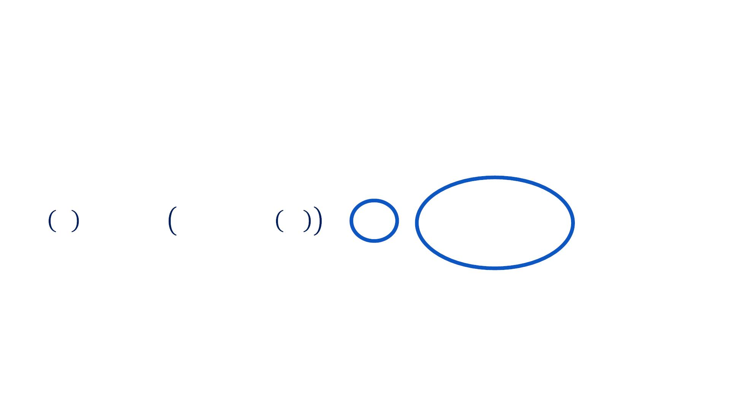
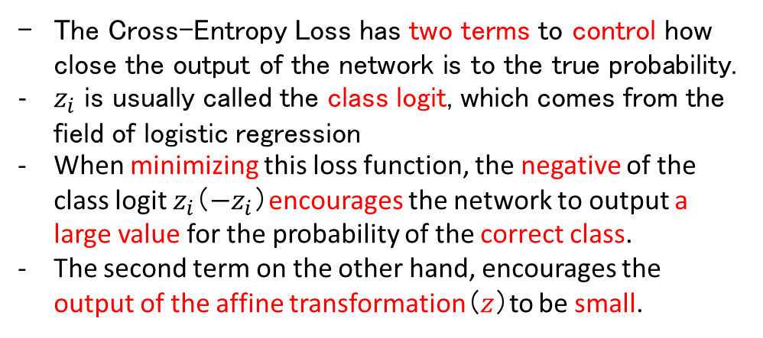
Classification: Cross-Entropy Loss Function
交差エントロピー
• By considering the output of the softmax output layer as a
probability distribution, the Cross Entropy Loss function is
derived using maximum likelihood as:
! " = − log ()*+,-. / = −/ + log 1 exp(/ )
!
!
"
The Cross-Entropy Loss has two terms to control how close the output of the network is to the true probability.
$z_{i}$ is usually called the class logit, which comes from the field of logistic regression
When minimizing this loss function, the negative of the class logit $z_{i}$（$−z_{i}$）encourages the network to output a large value for the probability of the correct class.
The second term on the other hand, encourages the output of the affine transformation（$z$）to be small.
"

Slide 19
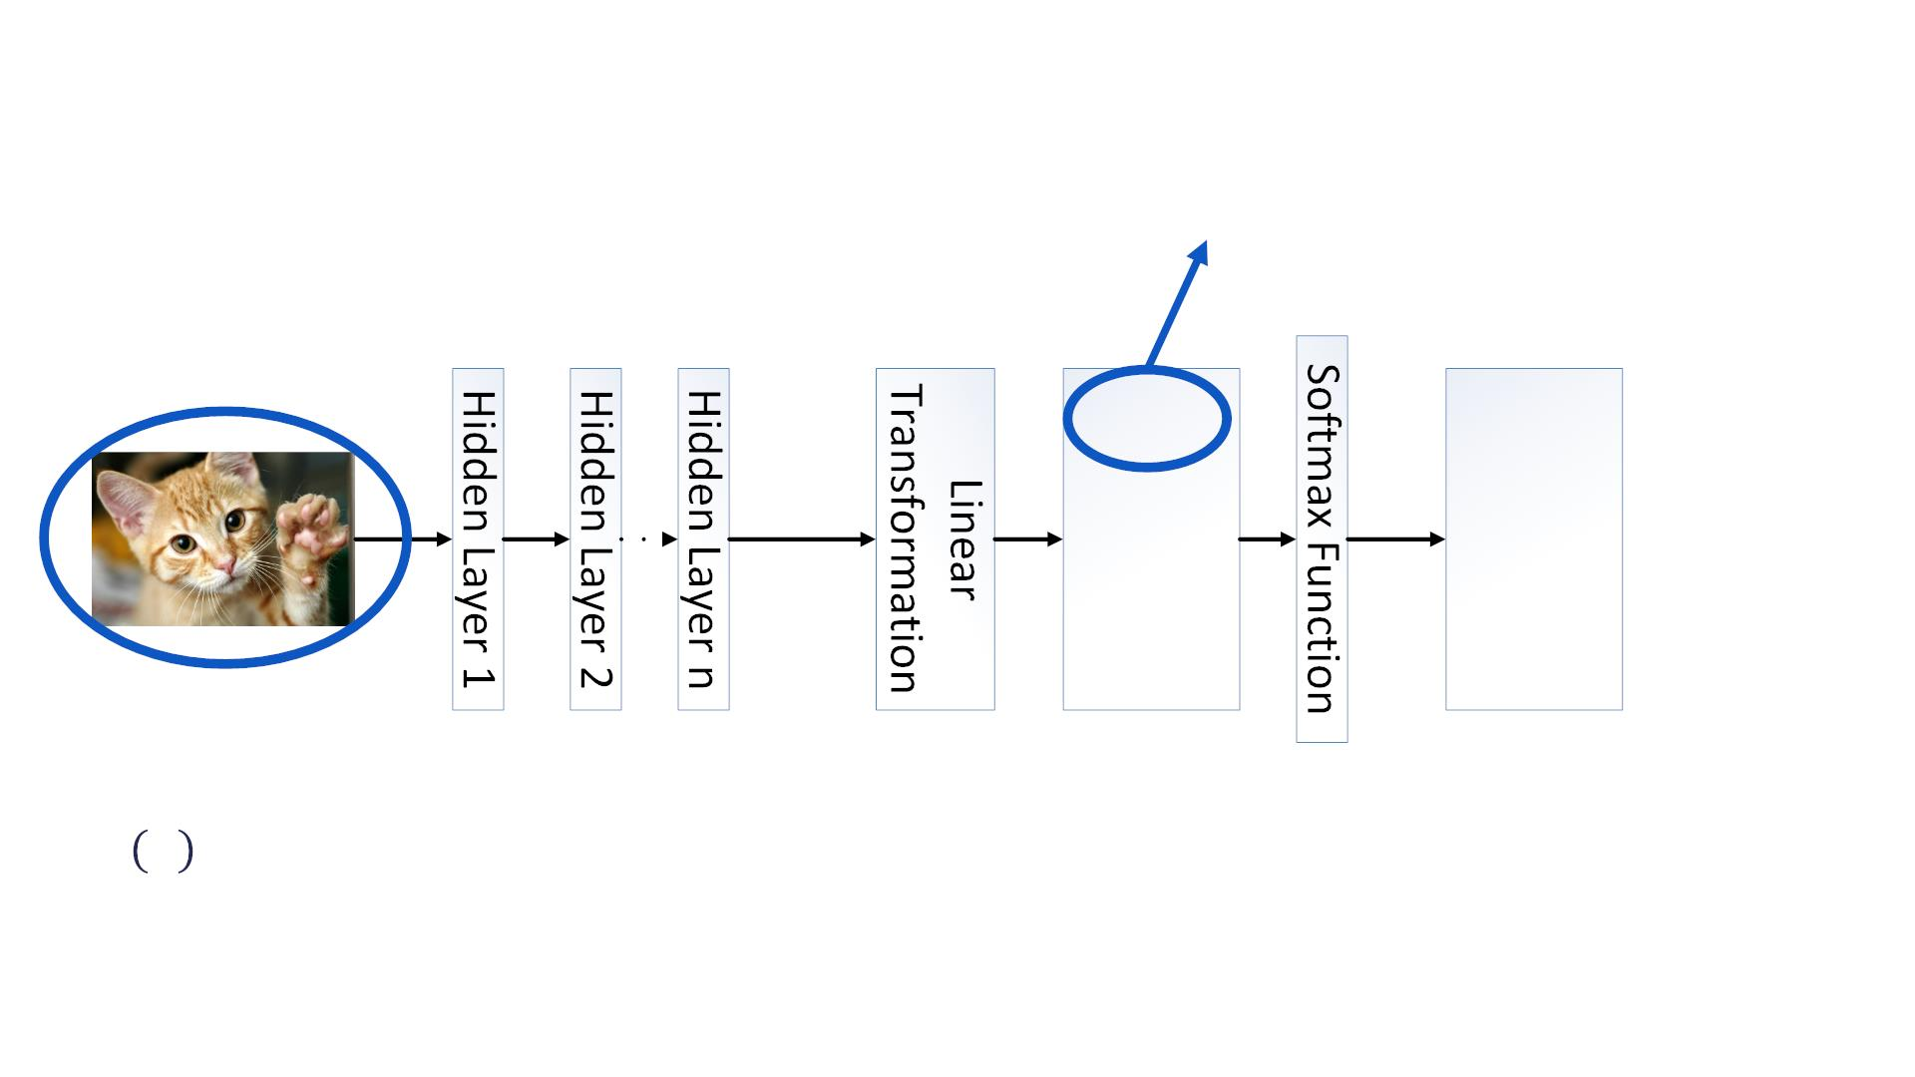
Classification: Softmax Output Layers
!" = 13
Cat
Dog
Fox
13
-7
Cat
Dog
Fox
0.88
1e-9
11
0.119
& ' = −) + log . exp() ) = −13 + log(exp(13) + exp(−7) + exp(11)) = 0.12
"
/
/

Slide 20
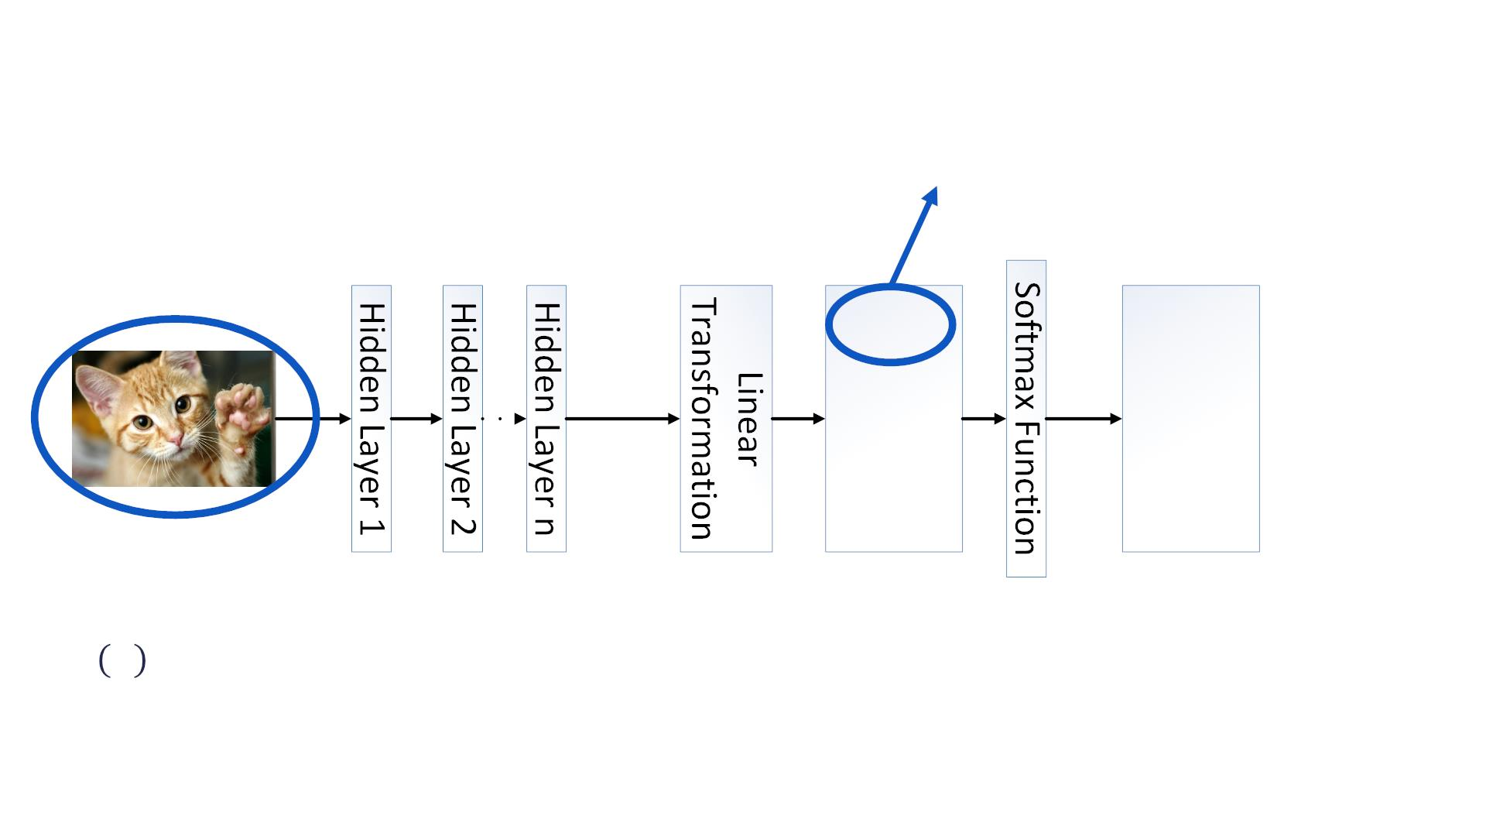
Classification: Softmax Output Layers
!" = 13
Cat
Dog
Fox
13
-7
Cat
Dog
Fox
0.27
5e-10
0.73
14
& ' = −) + log . exp() ) = −13 + log(exp(13) + exp(−7) + exp(14)) = 1.31
"
/
/
Note how the loss function heavily penalizes erroneous predictions even when the difference in output is only one.
- This difference accelerates the learning process and rapidly steers network outputs to the true values during training.

Slide 21
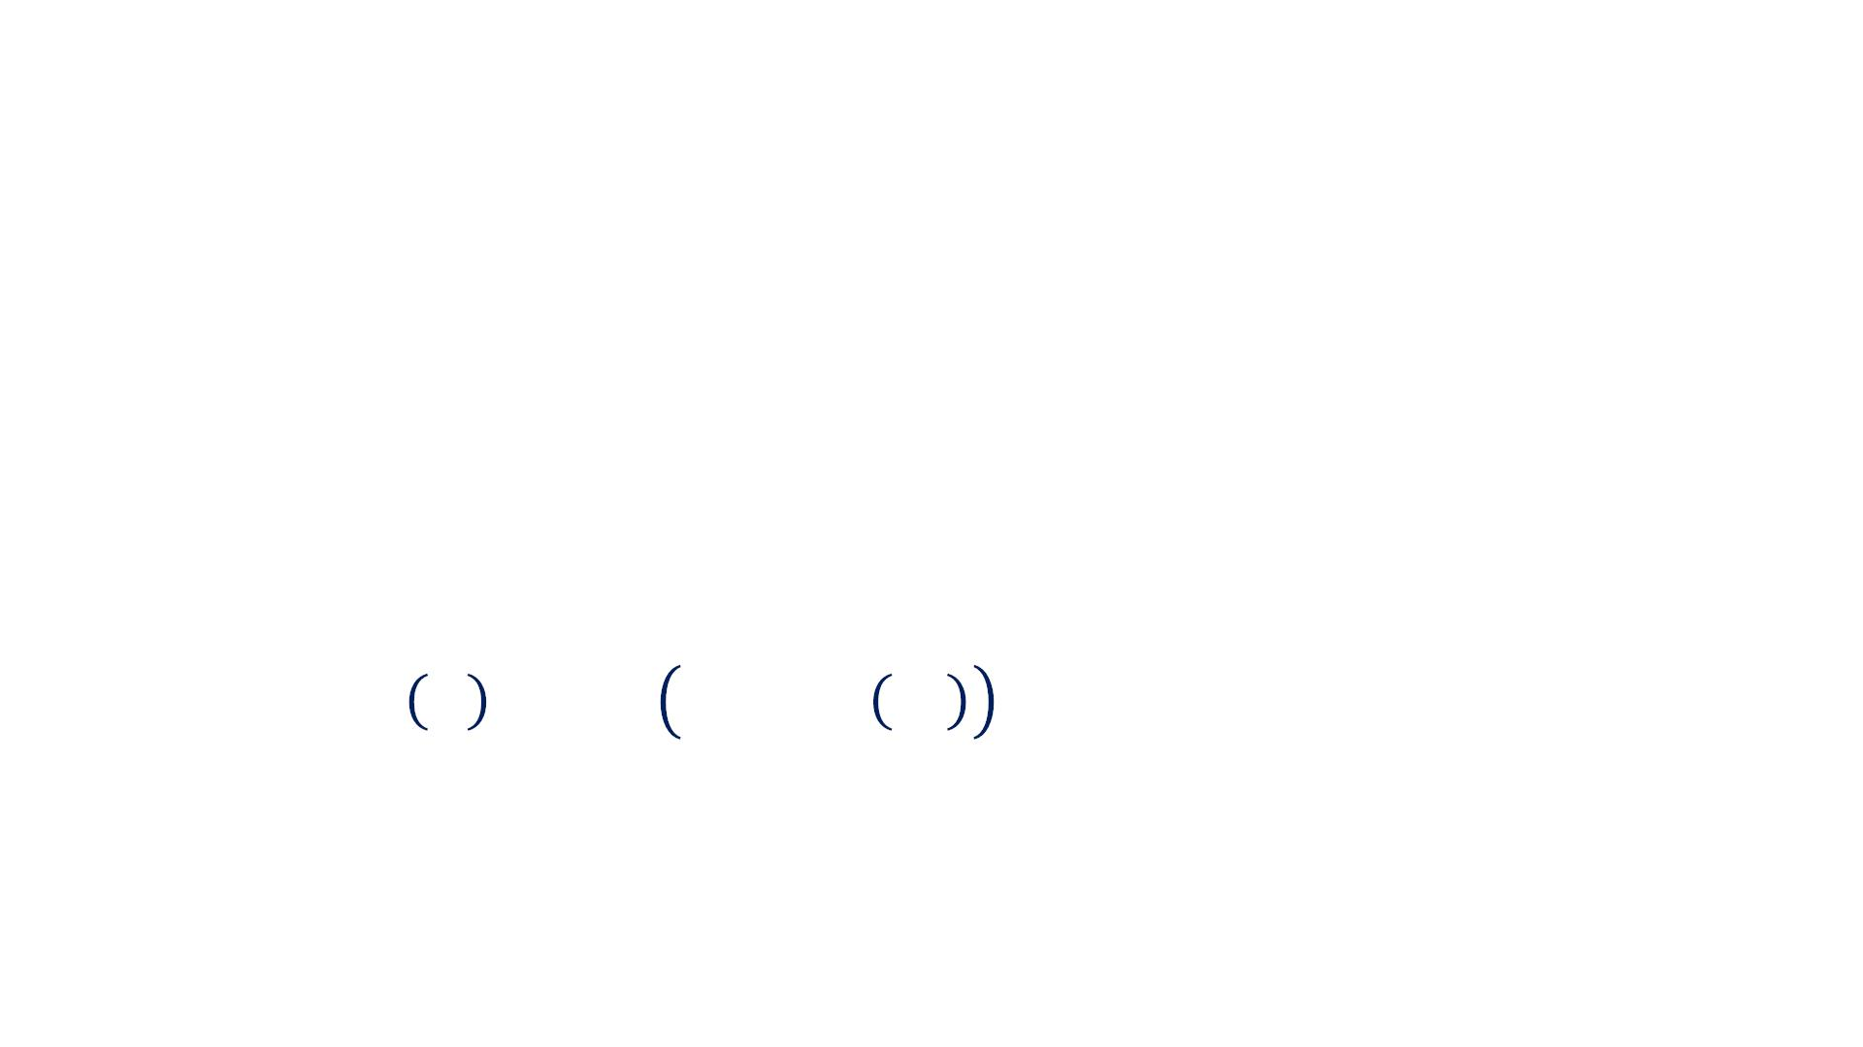
Regression: Linear Output Layers
• Linear Output Units are based only on an affine
transformation with no non-linearity
! = #!ℎ + &
• Linear Output Units are usually used with the Mean
Squared Error loss function to model the mean of a
probability distribution:
平均2乗誤差
∗
$
' ( = ) ! − + ,
"
"
"

Slide 22
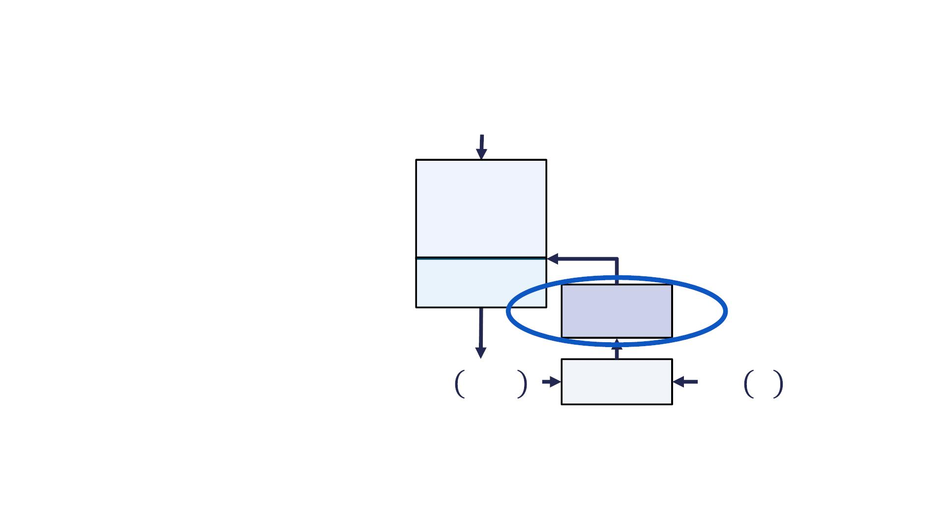
Summary
$
• To build a machine learning
model you need:
o A model
o A loss function
o An optimization procedure
Hidden
Layers
• Loss functions are chosen
Output Layer
based on the task at hand
Optimization
• Next: Optimization
! = # $; &
#∗ $
Loss Function

Slide 23
Neural Network Training With Gradient Descent
Course 3, Module 3, Lesson 3

Slide 24
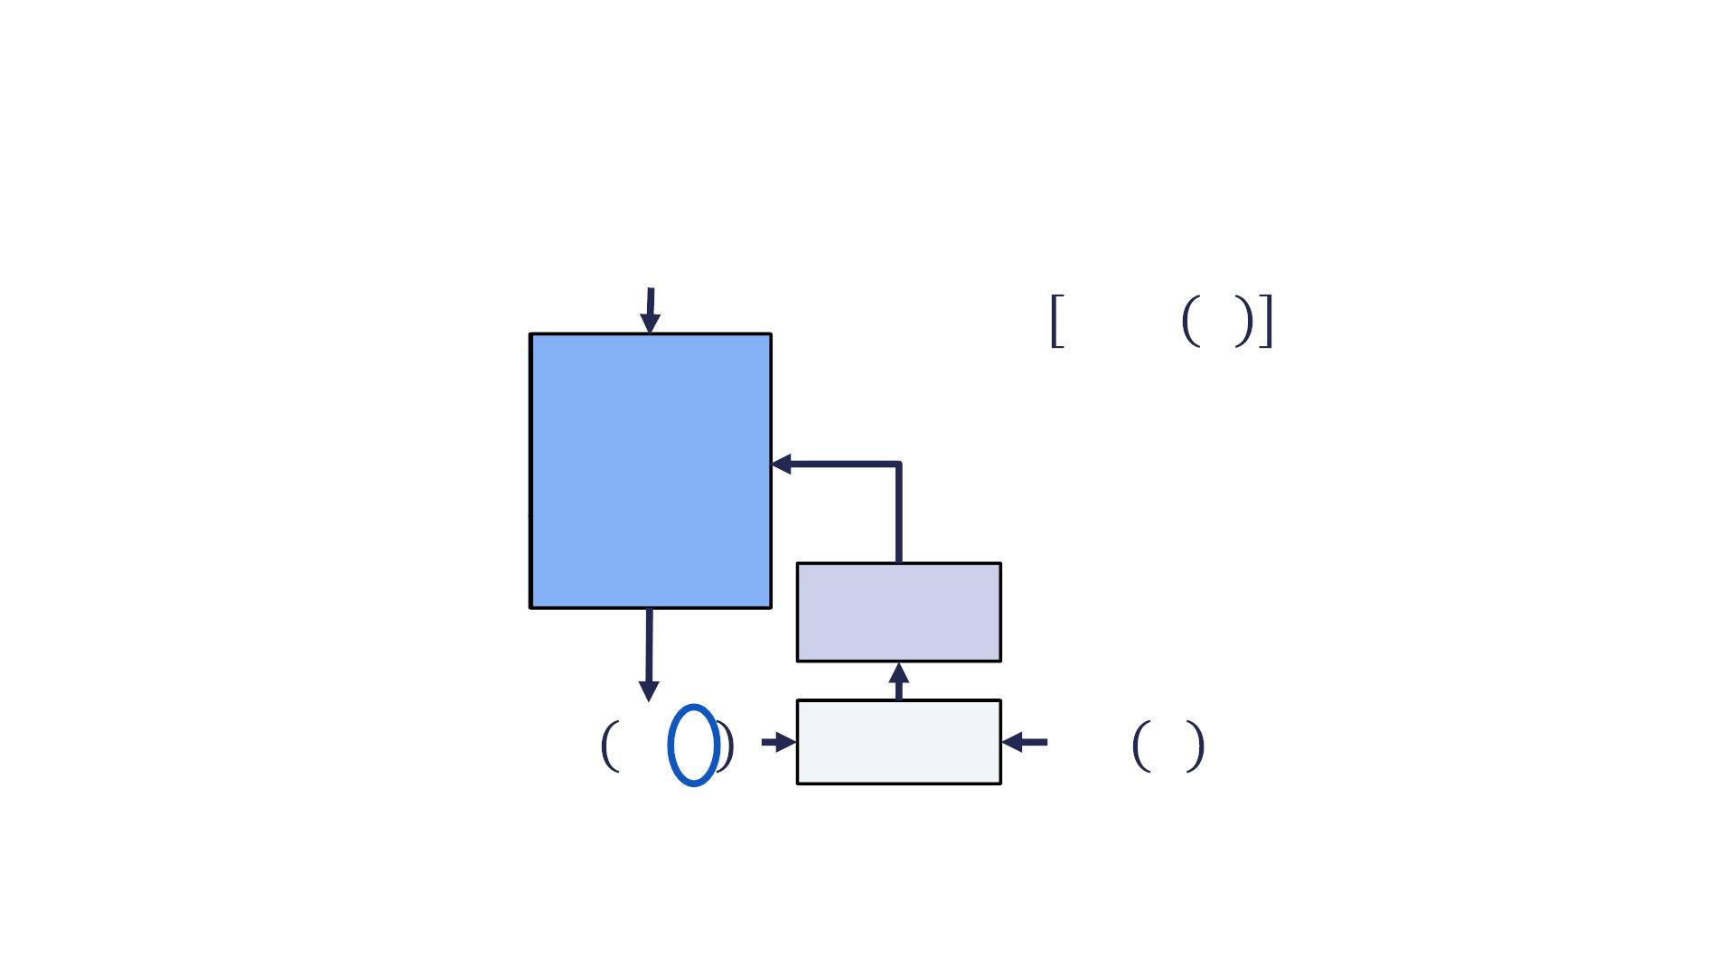
Artificial Neural Networks
$
'()*+*+, -).)
/, #∗ /
Neural
&!"#
Network
Optimization
! = # $; &
#∗ $
Loss Function

Slide 25
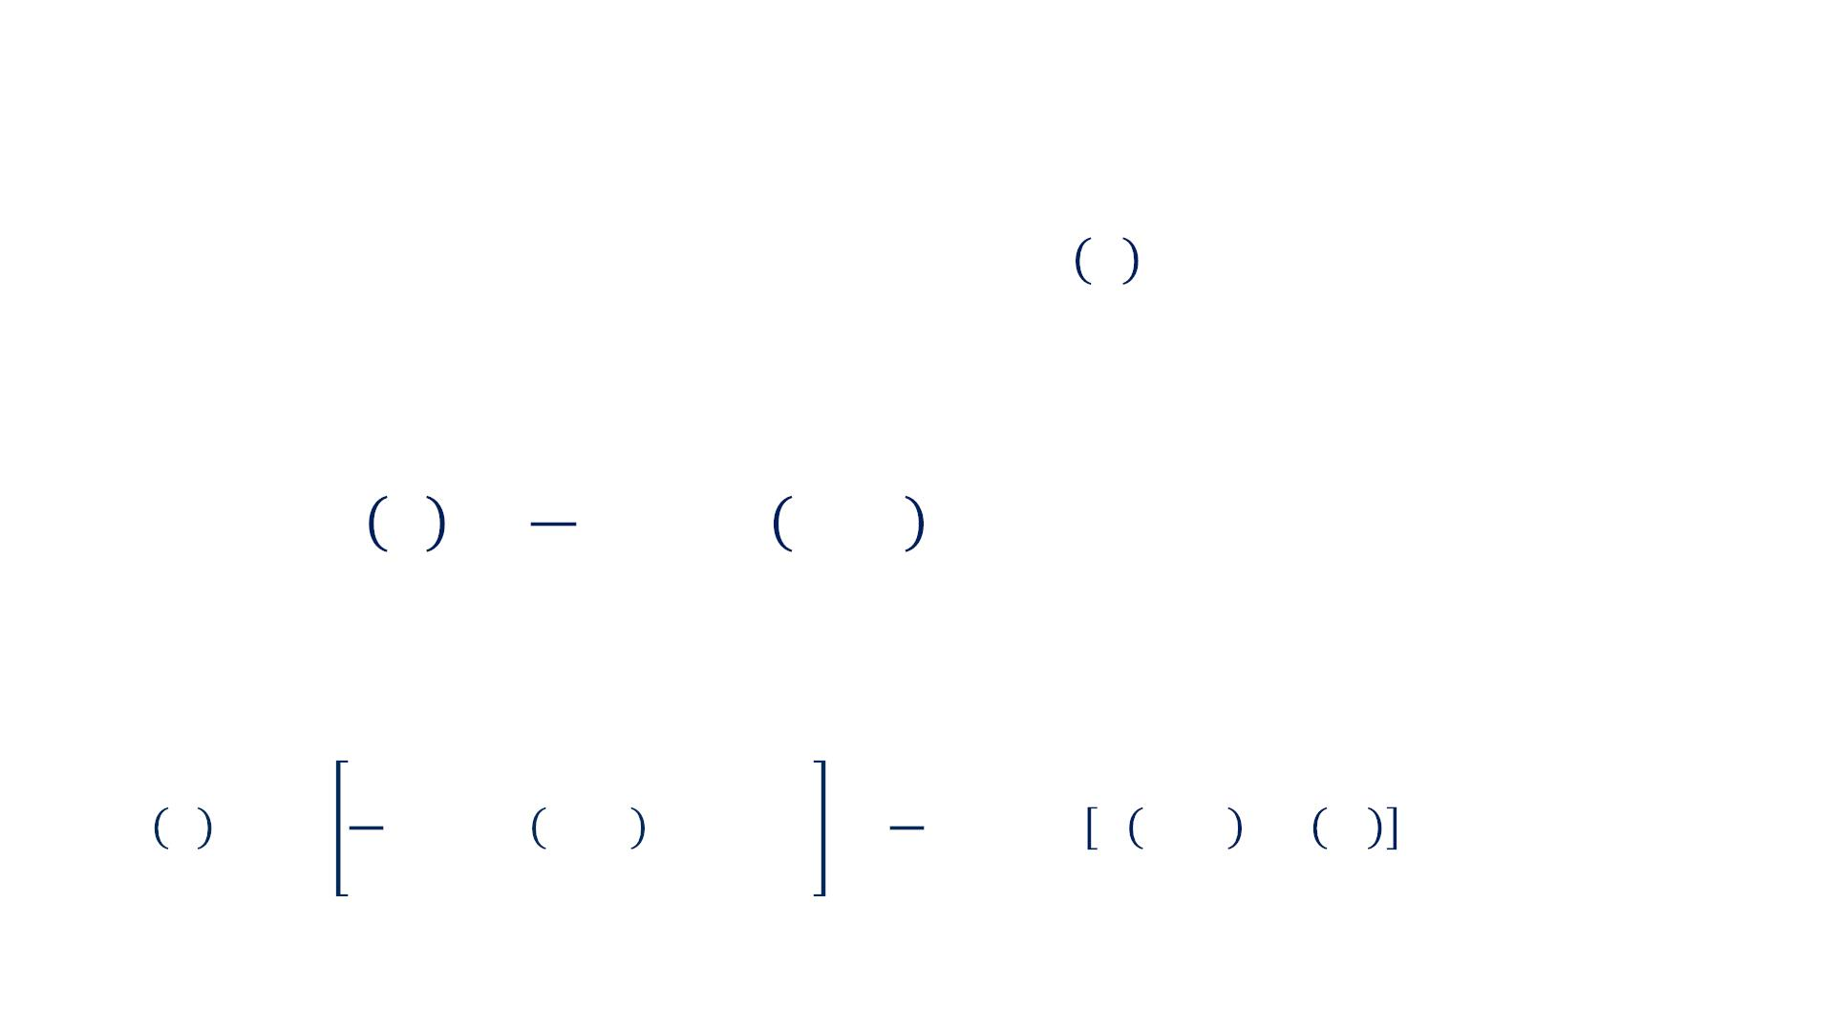
Neural Network Loss Functions
• Thousands of training example pairs [", #∗ " ]
• The Loss function computed over all N training examples
is termed the Training Loss and can be written as:
$
1
∗
! " = & '[) * , " , ) (* )]
%
!
!
!"#
• The gradient of the training loss with respect to the
parameters & can be written as:
2
2
1
1
∗
∗
' ) * = ' . 3[# 4 , * , # (4 )] = . ' 3 # 4 , * , # 4
(
(
-
/
/
-
(
/
/
/01
/01
using the fact that the gradient and the sum are linear operators.

Slide 26
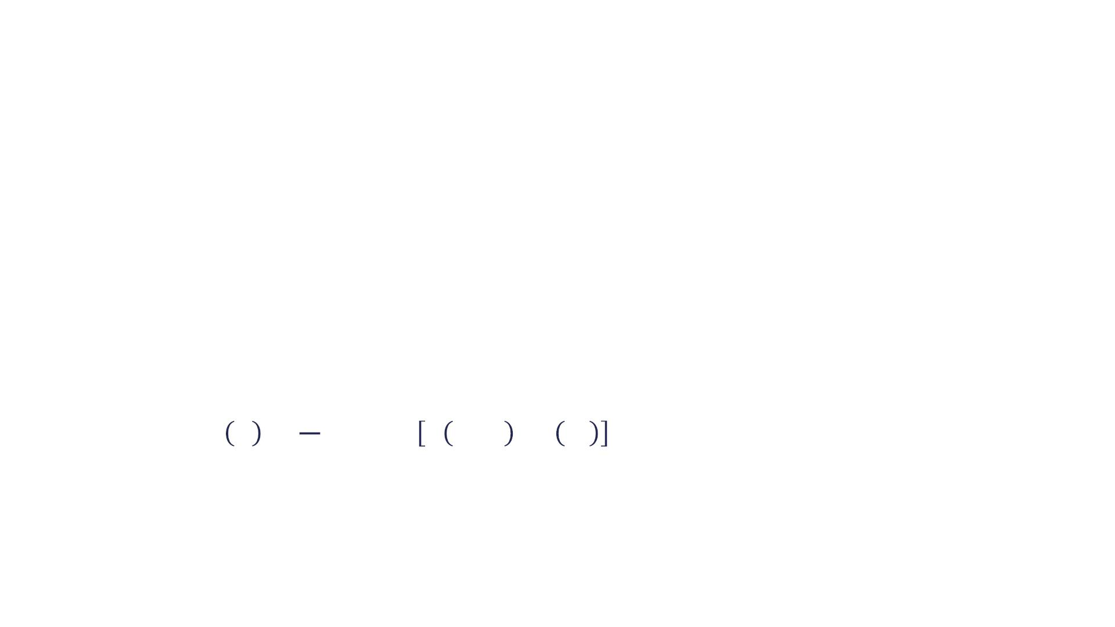
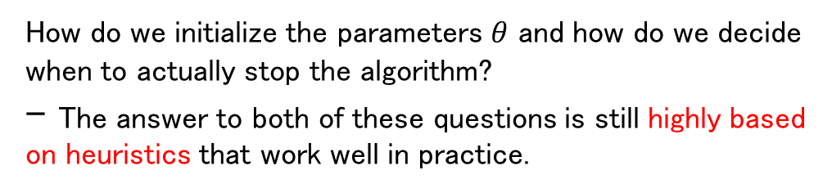
Batch Gradient Descent
• Batch Gradient Descent is an iterative first order
optimization procedure
• Batch Gradient Descent Algorithm:
o Initialize parameters !
o While Stopping Condition is Not Met:
§ Compute gradient of loss function over all training examples:
-
1
∗
" $ % = ) " . / 0 , % , / 0
#
(
#
*
*
*+,
How do we initialize the parameters $θ$ and how do we decide when to actually stop the algorithm?
- The answer to both of these questions is still highly based on heuristics that work well in practice.
§ Update parameters according to:
% ← % − 5"#$(%)

Slide 27
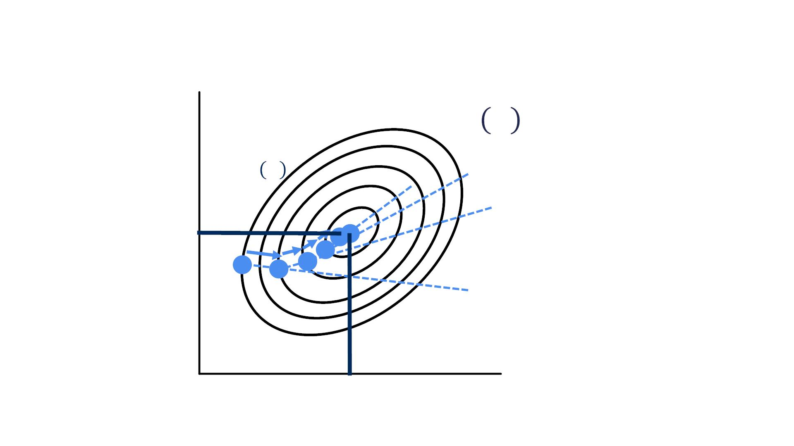
Batch Gradient Descent
!₂
! "
−$%"! "
∗
"
(
Initialize parameters "
∗
!1
"
&

Slide 28
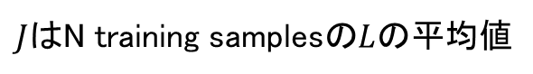
Parameter Initialization and Stopping
Conditions
• Parameter Initialization:
o Weights: initialized by randomly sampling from a standard
normal distribution
o Biases: initialized to 0
o Other heuristics exist
• Stopping Conditions:
o Number of iterations: How many training iterations the neural
network has performed
o Change In ! value: Stop if ! − ! < Threshold
"#$
&'(
o Change In *(!) value: Stop if -(! ) − -(! ) < Threshold
"#$
&'(
$J$はN training samplesの$L$の平均値

Slide 29
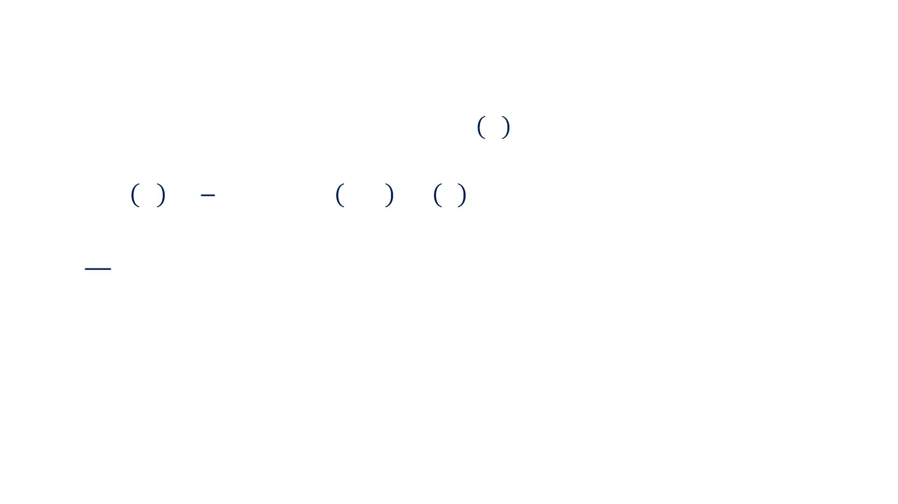
Batch Gradient Descent
• Backpropagation used to compute !"# " is very
原因：Backpropagation involves computing the output of the network for the example on which we would like to evaluate the gradient.
expensive to compute over the whole training dataset.
$
'
∗
! " # = ∑ ! & [( ), + , ( ) ] is a mean!
"
%
& "
&
&
• Standard error of the mean estimated from ) samples
*
is , where , is the standard deviation of the value
√'
of the samples
平方根「へいほうこん」
• Using all samples to estimate the gradient results in
less than linear return in accuracy of this estimate
• Use a small subsample (Minibatch) of the training
data to estimate the gradient!

Slide 30
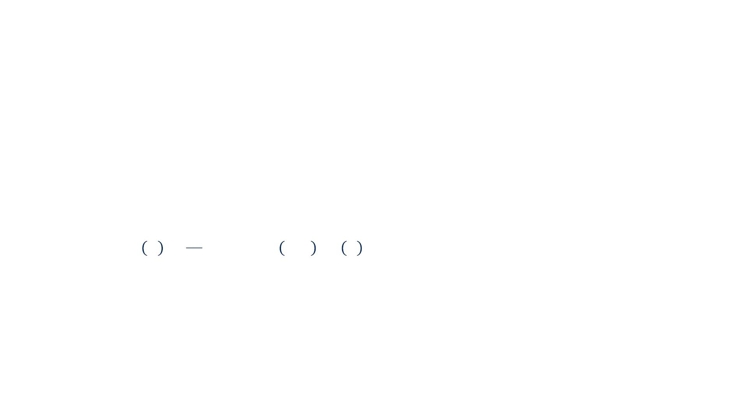
Stochastic (minibatch) Gradient Descent
• Stochastic (minibatch) Gradient Descent Algorithm:
o Initialize parameters !
o While Stopping Condition is False:
1. Sample a preset number "# of examples (minibatch) from the
training data
2. Compute gradient of Loss Function Over all training examples:
#!
1
∗
$ % & = * $ + [- ., & , - . ]
!
"′
!
"
"
"
3. Update parameters according to:
& ← & − 3$₄%(&)

Slide 31
What Minibatch Size To Use ?
2の累乗数、2の冪「べき」
「Deep Learning」p270~275: 8.1.3 Batch and Minibatch Algorithmsに全部書いてある ！
• GPUs work better with powers of 2 batch sizes
• Large batch sizes > 256:
「Deep Learning」p272によると、Small batches can offer a regularizing effect, perhaps due to the noise they add to the learning process. Generalization error is often best for a batch size of 1. Training with such a small batch size might require a small learning rate to maintain stability because of the high variance in the estimate of the gradient. The total runtime can be very high as a result of the need to make more steps, both because of the reduced learning rate and because it takes more steps to observe the entire training set.
o Hardware underutilized with very small batch sizes.
o More accurate estimate of the gradient, but with less than linear
returns
• Small batch size < 64
o Small batches can offer a regularizing（正則化） effect. The best
generalization error is often achieved with batch size of 1.
o Small batch sizes allow for faster convergence, as the algorithm
can compute the parameter updates rapidly
• Always make sure dataset is shuffled before sampling
minibatch
As a result of these trade-offs, typical power of two minibatch sizes range from 32 to 256, with smaller sizes sometimes being attempted for large models or to improve generalization.

Slide 32
SGD Variations
• Many variations of SGD exist
o Momentum SGD, Nestrove Momentum SGD
o Ada-Grad, RMS-Prop
o ADAM (Adaptive Moment Estimation)
• Which one to use ?
o ADAM: Implemented in most deep neural network libraries, fairly
robust to the choice of the learning rate and other
hyperparameters
• http://deeplearningbook.org

Slide 33
Summary
• You can optimize for neural network parameters using
batch gradient descent
• When the number of training examples is extremely
large, you can use minibatch (stochastic) gradient
descent
• State-of-the-art optimization algorithms built on top of
SGD are implemented in most neural network libraries
• Next: Dataset Splits and Neural Network Performance
Evaluation

Slide 34
Data Splits and Neural Network Performance
Evaluation
Course 3, Module 3, Lesson 4

Slide 35
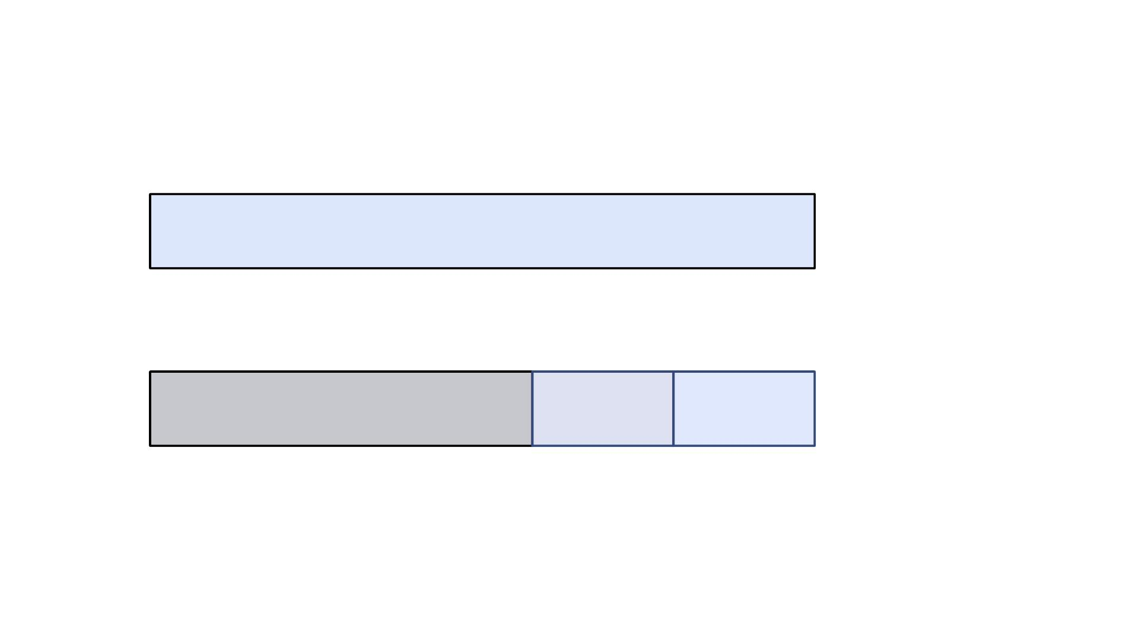
Given a large enough neural network, we are almost guaranteed to get a very low training loss.
- This is due to the very large number of parameters in a typical deep neural network allowing it to memorize the training data to a large extent given a large enough number of training iterations.
Data Splits
Data
~10000
Training
Validation
Testing

Slide 36
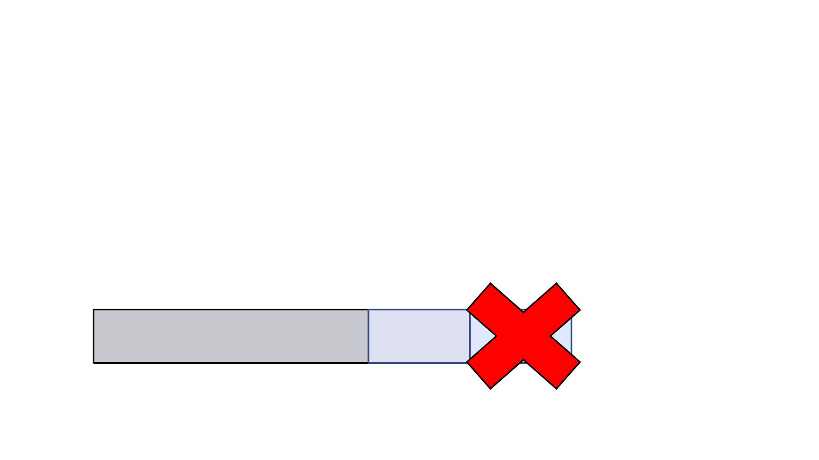
Hyperparameters are those parameters that either modify the network structure or affect the training process.
Data Splits
• Training Split: used to minimize the Loss Function
• Validation Split: used to choose best hyperparameters,
such as the learning rate, number of layers, etc.
• Test Split: the neural network never observes this set.
The developer never uses this set in the design
process
the number of units per layer, and the activation function type.
used to get an unbiased estimate of performance.
Training
Validation

Slide 37
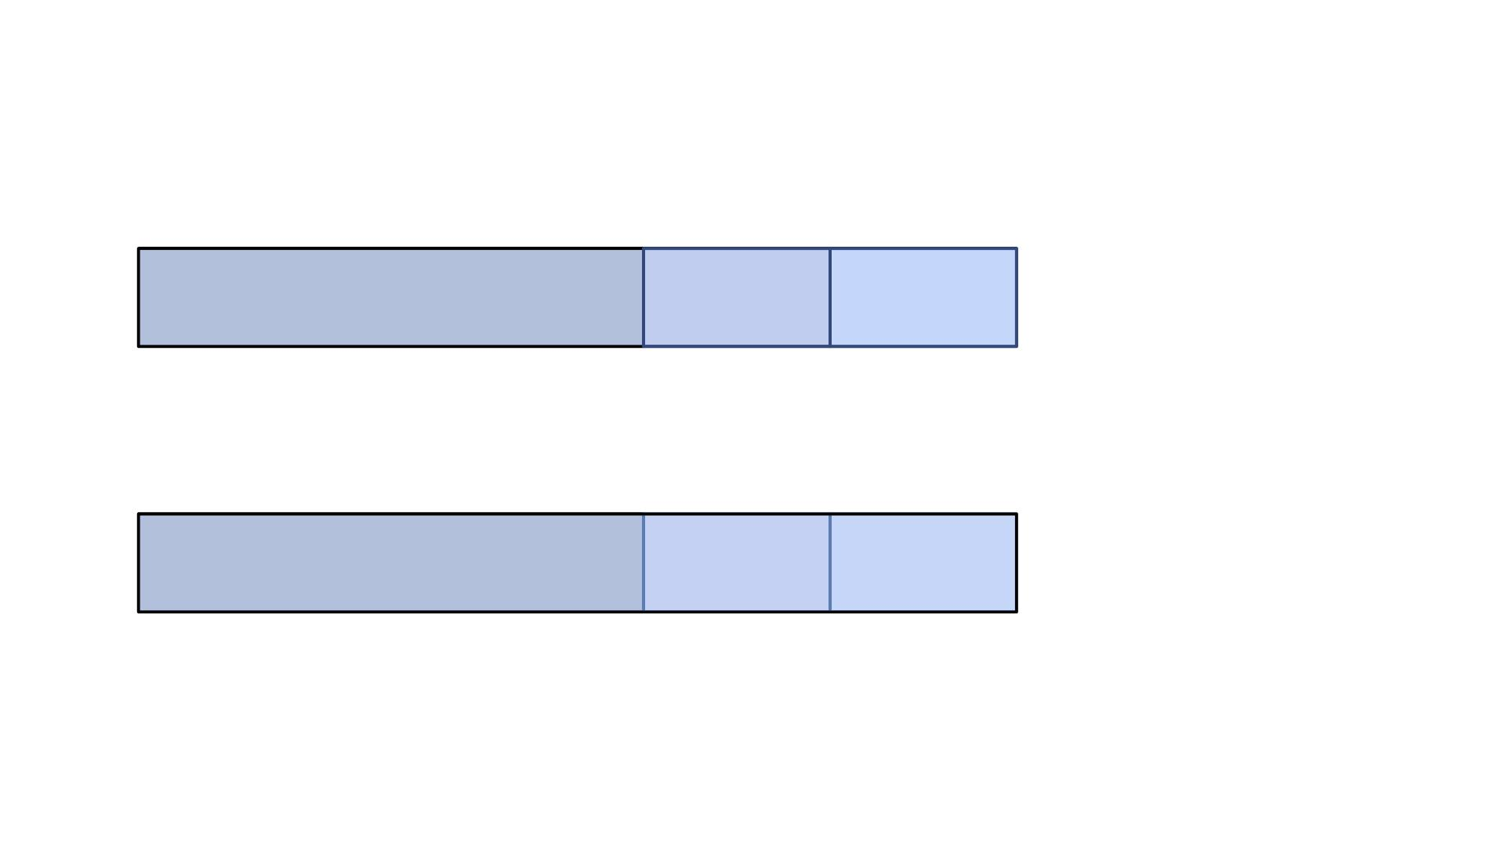
Data Splits
データのサイズによって各splitのpercentageは変わる
Data
Data
20% 20%
~10000
Training
Training
Validation
Testing
1% 1%
~1000000
Validation
Testing
Having 20% of the data in the validation and test sets is unnecessary as the validation and test would contain far more samples than are needed for the purpose.

Slide 38
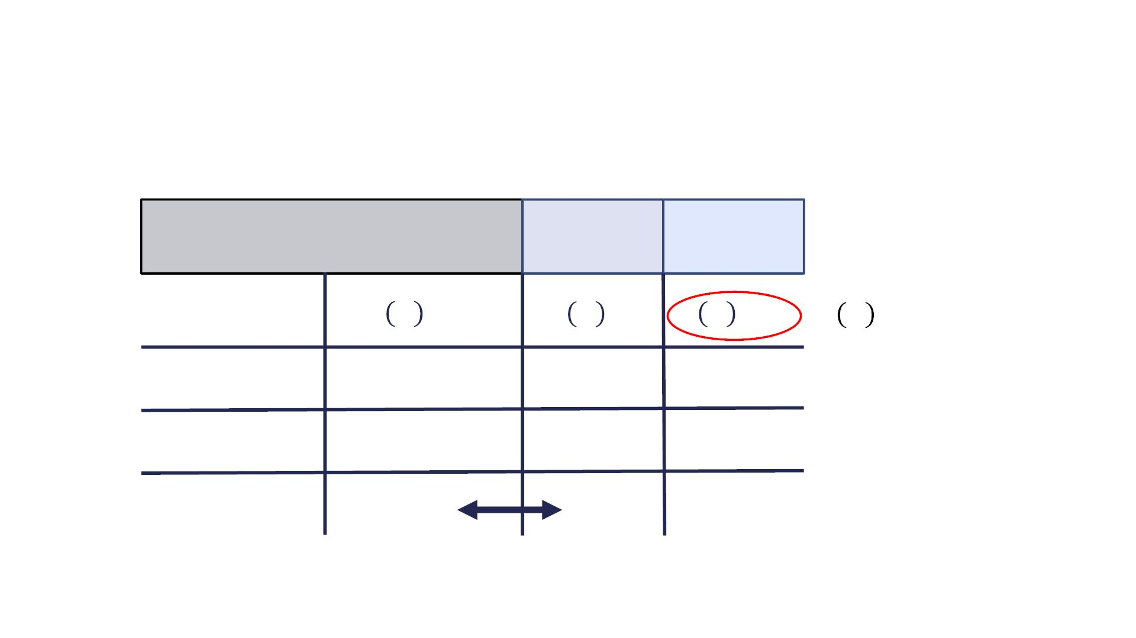
Good Estimator: the loss on the three sets are fairly consistent and the loss is close to the minimum achievable loss on the entire task.
Behavior of Split Specific Loss Functions
6000
2000 2000
Training
Validation
Testing
~10000
! "
#$%&'
! "
! "
! "
(%)
#*+#
4&'&565
Good Estimator
0.21
0.25
0.30
0.18
Underfitting
Overfitting
1.9
1.9
2.1
2.1
0.21
2.05
Underfitting: the neural network fails to bring the training loss down.
Overfitting: caused by the neural network optimizing its parameters to precisely reproduce（再現） the training data output.
The gap between training and validation loss is called the generalization gap.

Slide 39
Reducing the Effect of Underfitting/Overfitting
• Underfitting: (Training loss is high)
o Train longer
o More layers or more parameters per layer
o Change architecture
• Overfitting: (Generalization gap is large)
o More training data
If the architecture is suitable for the task at hand.
Unfortunately, for self-driving cars, collecting training data is very expensive as it requires engineering time for data collection and a tremendous amount of annotator time to properly define the true output.
o Regularization
o Change architecture

Slide 40
Summary
• A dataset should be split to a training, a validation
and a test split
• Observing the performance on each of these splits
helps in determining why a neural network is not
performing well in the real world
• Underfitting: Train longer or use a larger neural
network
• Overfitting: Regularization
A much more commonly faced scenario in self-driving car perception is overfitting.

Slide 41
Neural Network Regularization Strategy
Course 3, Module 3, Lesson 5

Slide 42
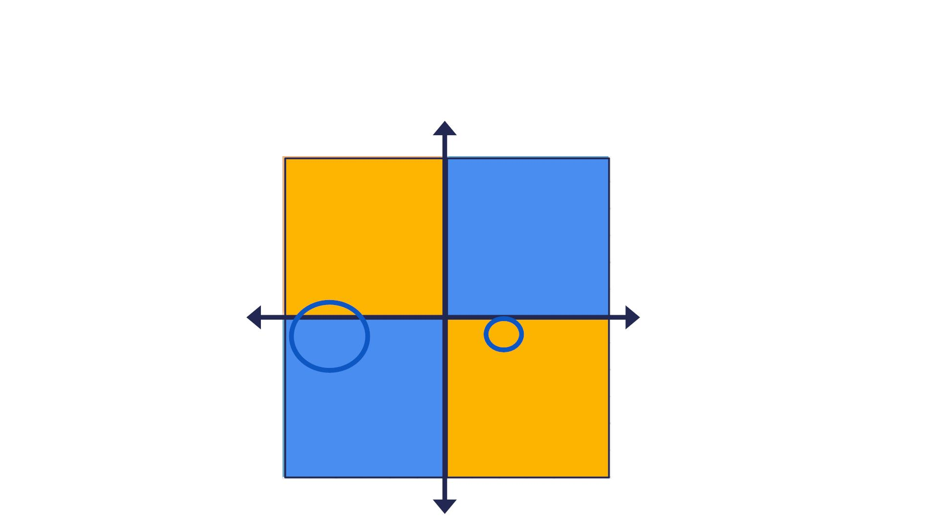
Toy Example
"
# #
" !
!
# #
! "

Slide 43
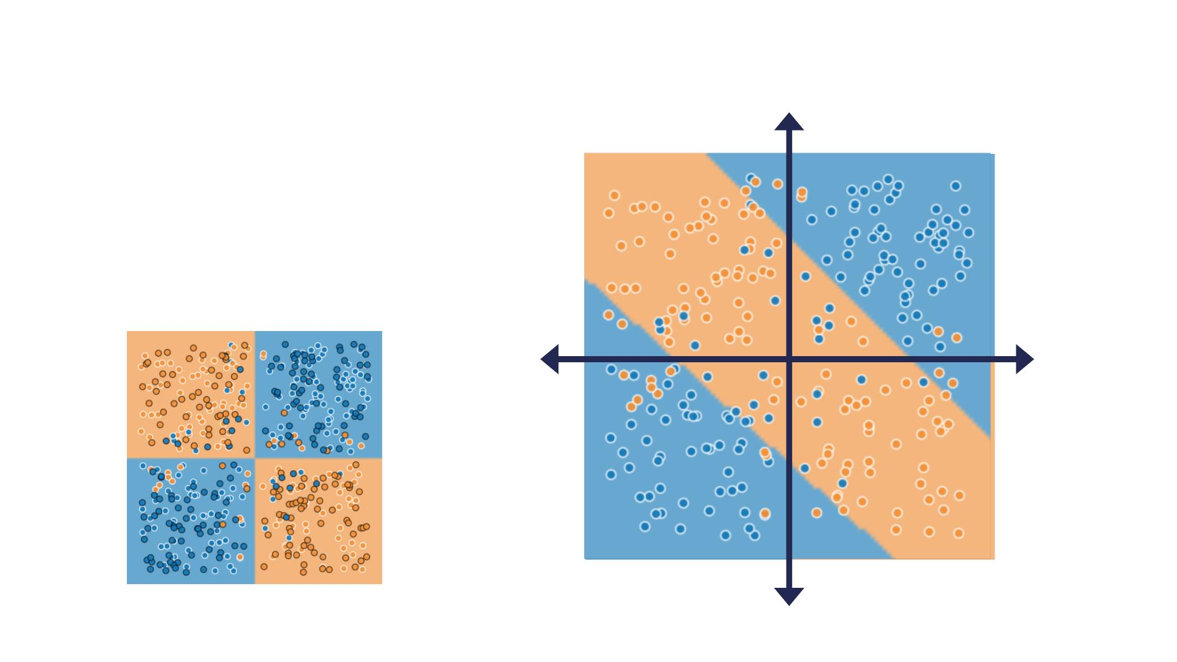
The neural network fails to capture the complexity of the problem at hand, and did not correctly segment the space into 4 compartments as required.
Toy Example
%
• Initial Design:
o 1 Layer NN, 2 Hidden Units/Layer
o Train set Loss: 0.264
o Val set Loss: 0.268
!#
!"
!#
o Minimum Loss achievable: 0.1
$

Slide 44
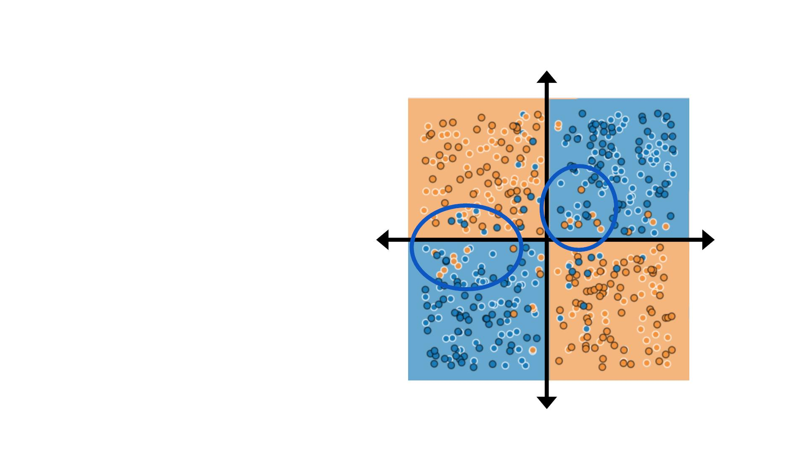
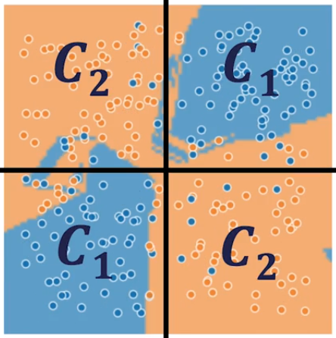
Toy Example
Y
• New Design:
!" !#
o 6 Layer NN, 6 Hidden Units/Layer
o Train set Loss: 0.1
o Val set Loss: 0.45
o Minimum Loss achievable: 0.1
X
Overfitting is caused by the network learning the noise in the training data.
- Because the neural network has so many parameters, it is able to curve out small regions in the space that correspond to the noisy training examples.
!# !"

Slide 45
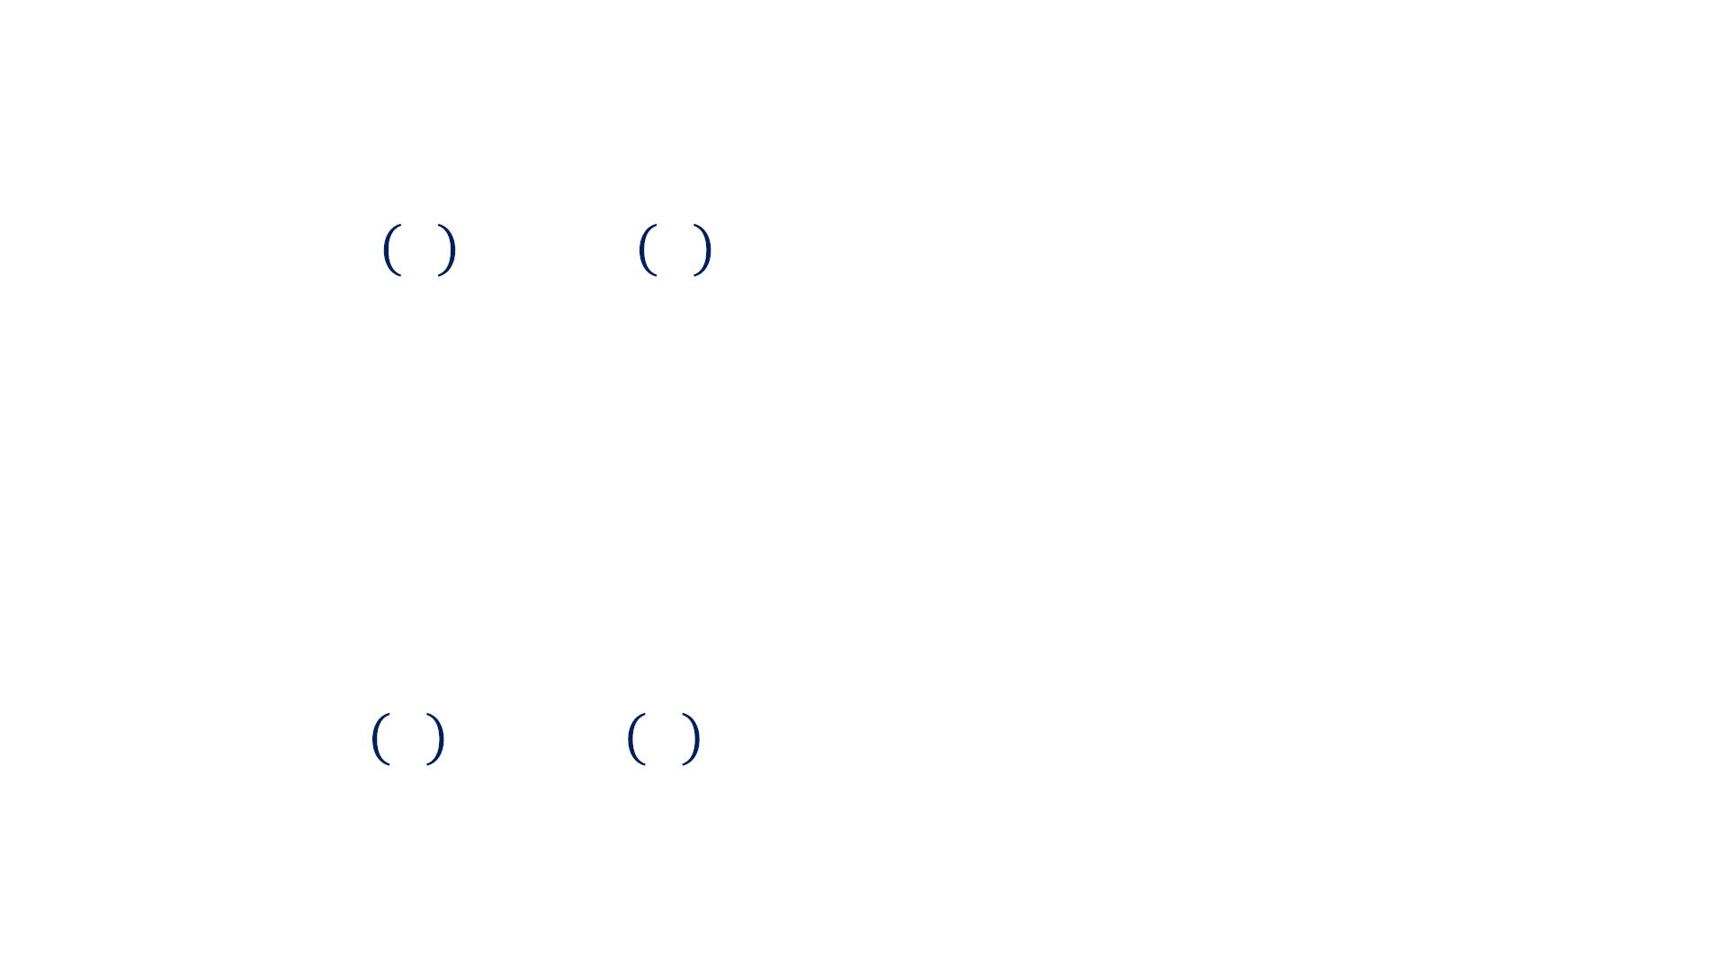
Parameter Norm Penalties
! " !"# = ! " + %Ω(")
• ! is a hyperparameter that weights the relative
contribution of the norm penalty to the value of the
loss function
• Ω($) is a measure of how large $’s value is, usually
an Lp Norm
• We usually only constrain the size of weights and
not biases
This is motivated by the fact that the number of weights is much larger than the number of biases in the neural network.
! " !"# = ! " + %Ω())
しかしDeep Learning 7.1 Parameter Norm Penalties page 223によると、理由はこれじゃない。理由は2つある
First, “Each weight specifies how two variables interact. Fitting the weight well requires observing both variables in a variety of conditions. Each bias controls only a single variable. This means that we do not induce too much variance by leaving the biases unregularized.”
Second, “Regularizing the bias parameters can introduce a significant amount of underfitting.”

Slide 46
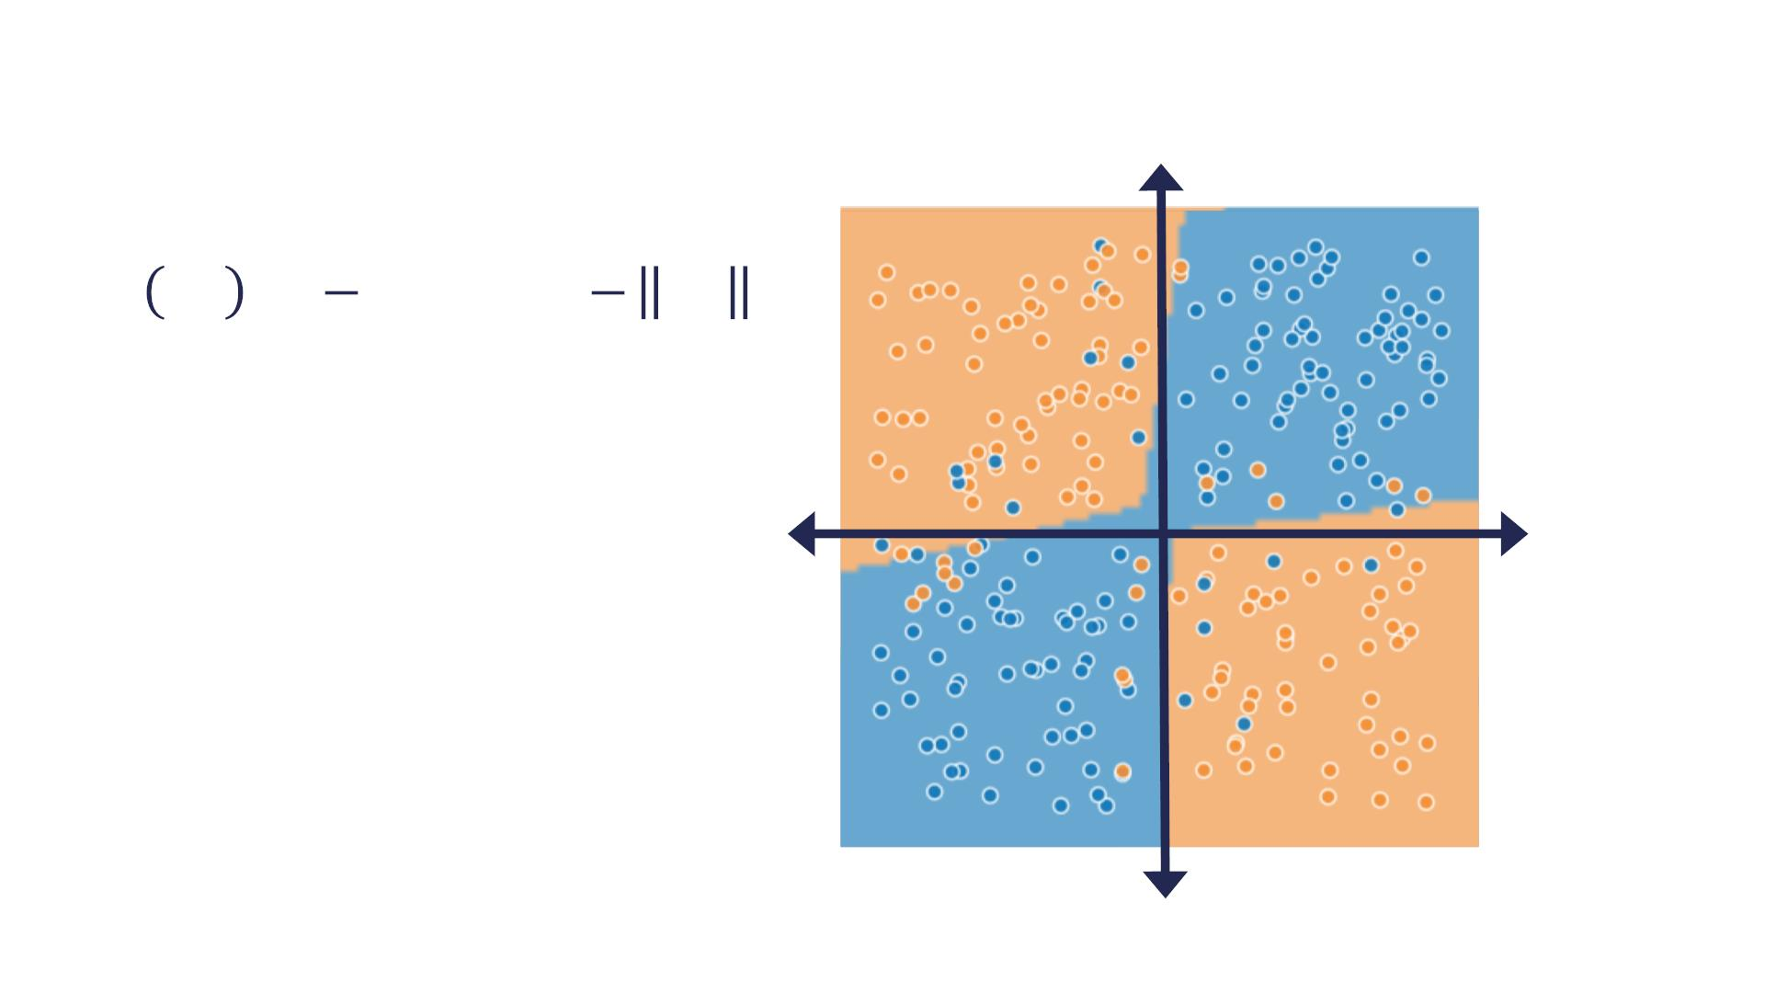
L2-Norm Parameter Penalty
1
1
!
"
Ω " = " " = "
2
2
"
&' &₍
&₍ &'
• New Design:
o 6 Layer NN, 6 Hidden Units/Layer
o Minimum Loss achievable: 0.1
o L2-Norm Penalty
o Train set Loss: 0.1
o Val set Loss: 0.45
0.176
0.182
In this case, the decrease in the generalization gap is higher than the increase in training set loss.

Slide 47
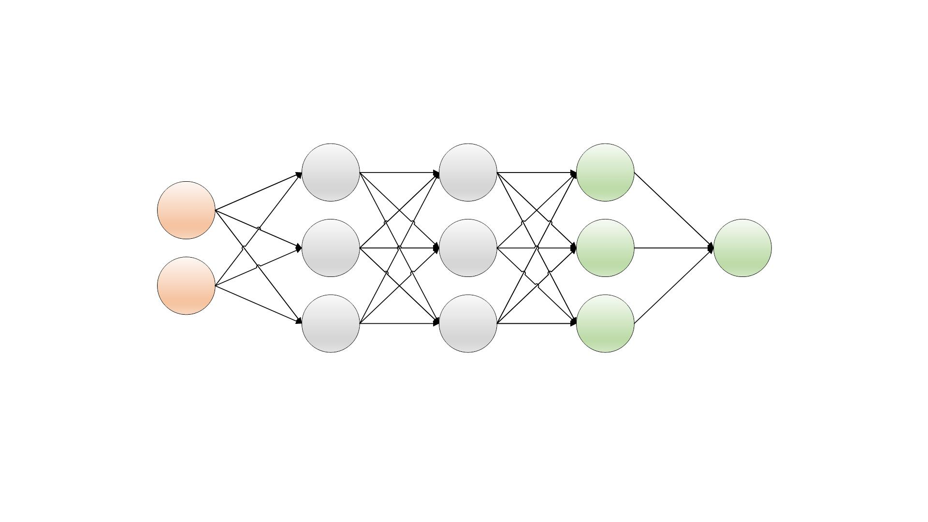
Dropout
Multiply Weights by !!""# at the end of training
hh11
h2
h3
gg11
g2
g3
hh11
h2
h3
X1
X2
y
! = 0.5
"##$

Slide 48
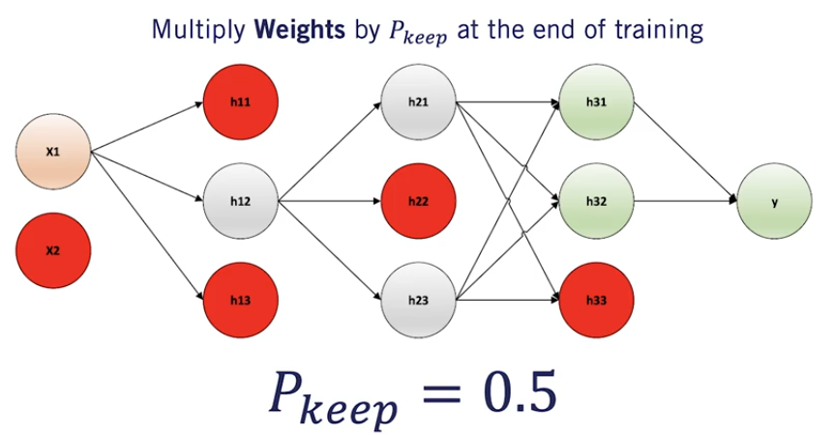
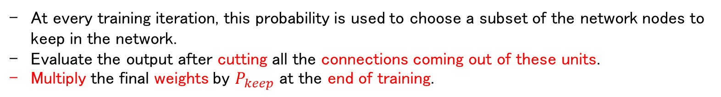
Dropout can be intuitively explained as forcing the model to learn with missing input and hidden units.
Or in other words, with different version of itself.
Dropout
Multiply Weights by !!""# at the end of training
hh11
h2
h3
gg11
g2
g3
hh11
h2
h3
X1
X2
y
! = 0.5
"##$
At every training iteration, this probability is used to choose a subset of the network nodes to keep in the network.
Evaluate the output after cutting all the connections coming out of these units.
Multiply the final weights by $P_{keep}$ at the end of training.

Slide 49
Dropout
• Computationally inexpensive but powerful
regularization method
• Does not significantly limit the type of model or
training procedure that can be used
• Dropout layers are practically implemented in all
neural network libraries !
We recommend using dropout whenever you have dense feedforward neural network layers.
ですが、「Deep Learning with PyTorch」のp222の「Keeping activations in check: Batch Normalization」の中にこの言葉がある：「The authors of the paper suggest that using batch normalization eliminates or at least alleviates the need for dropout.」

Slide 50
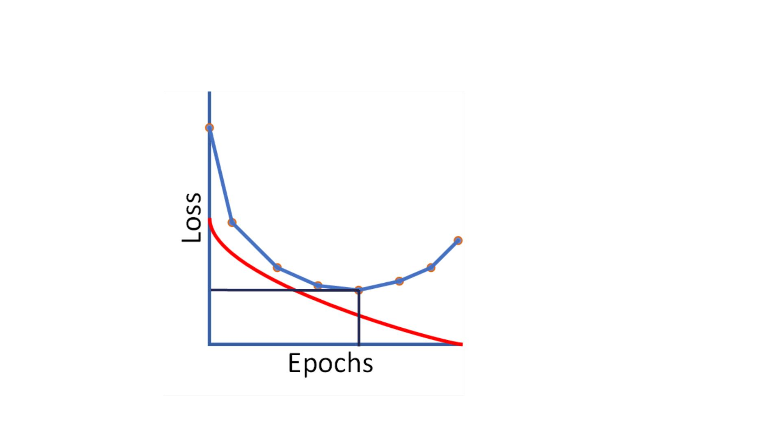
Early Stopping
Early stopping ends training when the validation loss keeps increasing for a preset number of iterations or epochs.
After stopping the training algorithm, the set of parameters with the lowest validation loss is returned. stopした時のparametersではない。
Early stopping should not be used as a first choice for regularization.
As it also limits the training time, which may interfere with the overall network performance.
Training Loss
Validation Loss
Lowest Validation Loss

Slide 51
Summary
• Regularization methods are used when the neural
network exhibits signs of overfitting
• For more information about regularization, check the
provided additional resources
• http://www.deeplearningbook.org/contents/regularization.html
• Next: Convolutional Neural Networks
Batch Normalizationは紹介されていない（Deep Learning勉強会資料「Chapter8_Optimization」に参考してください）。

Slide 52
Convolutional Neural Networks
Course 3, Module 3, Lesson 5

Slide 53
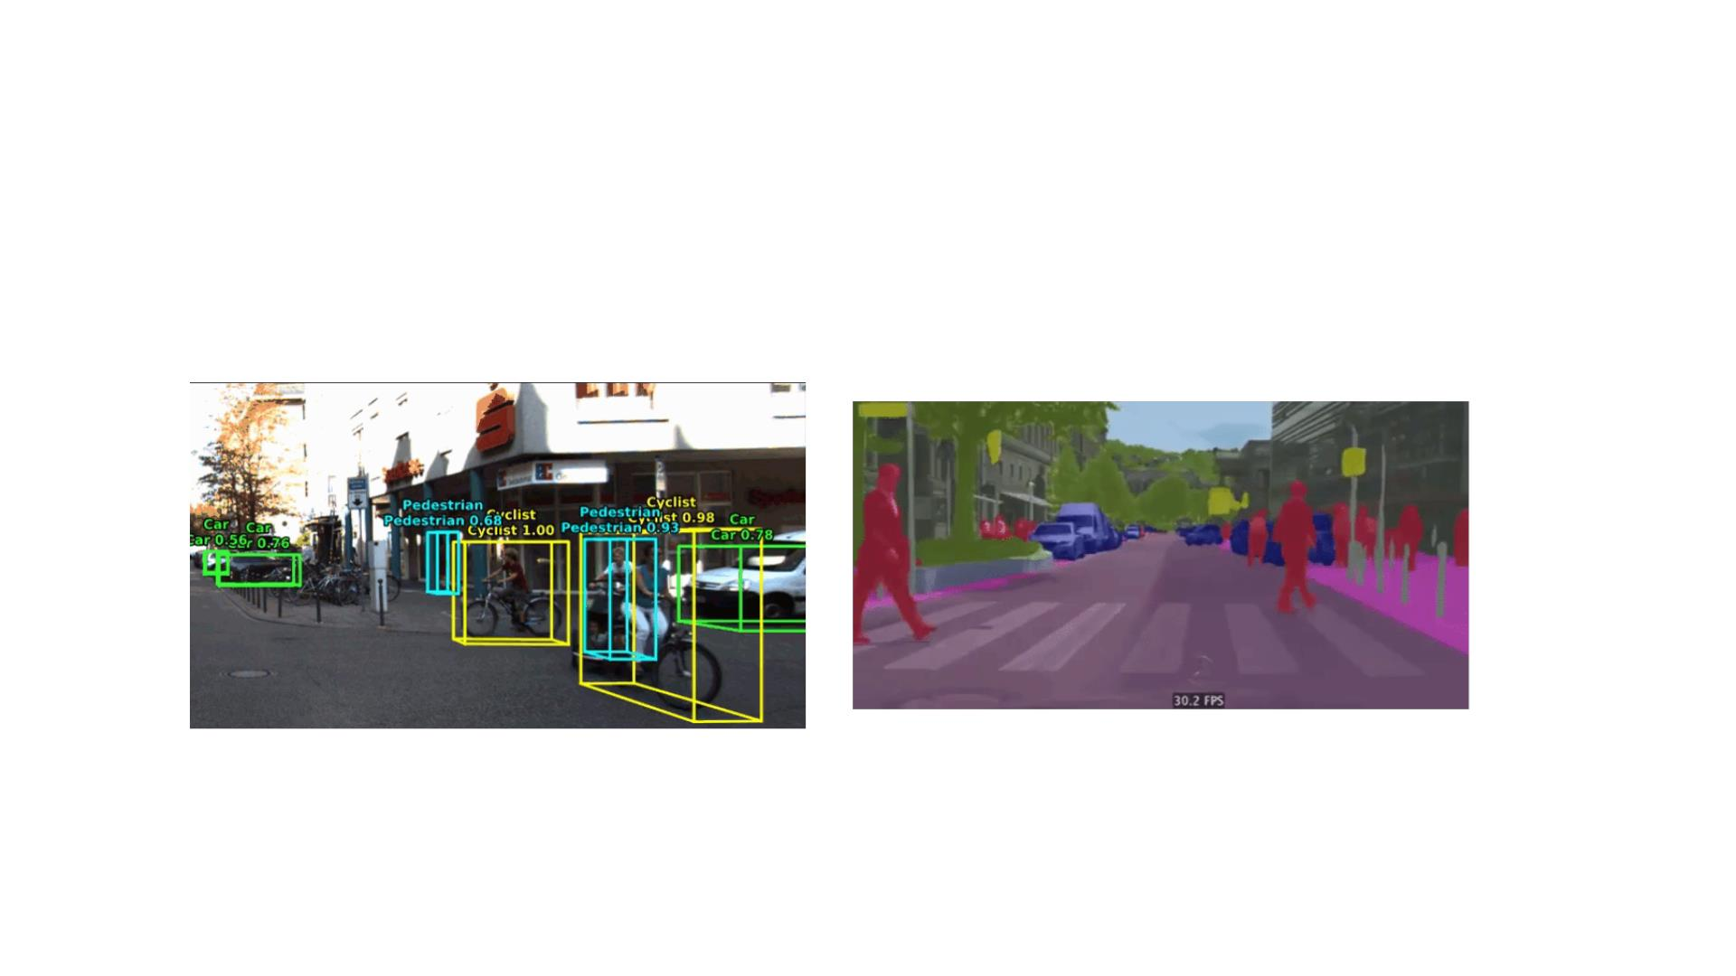
ConvNets For Self-Driving Cars
Code at: https://github.com/oandrienko/fast-semantic-segmentation
Code at: https://github.com/kujason/avod

Slide 54
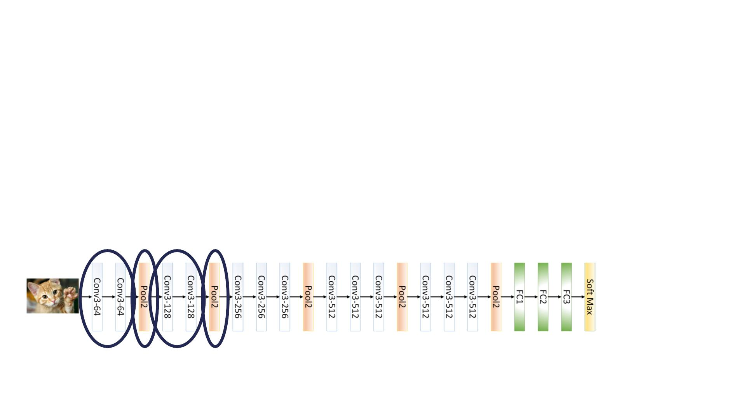
ConvNets
• Used for processing data defined on grid
• 1D time series data, 2D images, 3D videos
• Two major type of layers:
1. Convolution Layers
2. Pooling Layers
• Example: VGG 16

Slide 55

Fully Connected VS Convolutional Layers
Fully connected layers connect each node output to every node input in the next layer.
This is implemented in software through dense matrix multiplication.
h11
X1
h12
'
X2
X3
X4
ℎ = $(& ℎ + +)
"
"()
h13
h14
h15

Slide 56

Fully Connected VS Convolutional Layers
Although counter-intuitive, convolutional layers use cross-correlation not convolutions for their linear operator instead of general matrix multiplication.
The logic behind using cross-correlation is that if the parameters are learned, it does not matter if we flip the output or not.
Since we are learning the weights of the convolutional layer, the flipping does not affect our results at all.
h11
X1
h12
X2
X3
X4
ℎ = $(& ∗ ℎ + +)
"
"()
h13
h14
h15
This results in sparse connectivity.
Each input element to the convolutional layer only affects a few output elements, thanks to the use of a limited size kernel for the convolutional operation.

Slide 57

Cross Correlation
0
0
0
0
0
0
0
0
2
0
0
0
2
1
0
0
1
0
0
0
0
0
0
0
0
3
3
3
• Width: horizontal dimension
of input volume
• Height: vertical dimension
of input volume
• Depth: number of channels
of input volume
0
0
0
0
0
0
0
1
1
0
0
1
0
0
0
0
2
0
0
0
0
0
0
0
0
0
0
0
0
0
0
2
0
0
0
0
1
1
0
0
0
0
0
1
0
0
0
0
0
0
• Padding size: essential to
1
retain shape!

Slide 58

Each filter is comprised of a set of weights and a single bias.
The number of channels of the kernel needs to correspond to the number of channels of the input volume.
In this case, we have three weight channels per filter corresponding to red, green, and blue channels of the input image.
input imageの3つchannelsとfilterの3つchannelsとfilterのbiasが⼀緒に1つvalueを計算する。 つまりinput imageのchannel数とoutputの形は関係ない。
Cross Correlation
0
0
0
0
0
0
0
0
2
0
0
0
2
1
0
0
1
0
0
0
0
0
0
0
0
0
-1
0
-1
-1
-1
1
-1
1
0
0
0
0
0
0
0
1
1
0
0
1
0
0
0
0
2
0
0
0
0
0
0
0
0
1
-1
0
0
-1
1
-1
-1
0
Weights
Bias
0
1
1
1
0
1
1
-1
-1
0
0
0
0
0
0
2
0
0
0
0
1
1
0
0
0
0
0
1
0
0
0
0
0
0
1

Slide 59

Cross Correlation
Output
0
0
0
0
0
0
0
0
2
0
0
0
2
1
0
0
1
0
0
0
0
0
0
0
0
0
-1
0
-1
-1
-1
1
-1
1
2
+
0
+
4
+
1
1
1
1
1
-1
0
7
-5
1
-1
-1
-1
-1
1
-1
0
0
-1
1
-1
-1
0
0
-1
0
0
0
0
0
1
0
0
0
0
0
0
0
0
1
1
0
0
1
0
0
0
0
2
0
0
0
0
0
0
0
0
1
0
0
0
1
0
0
0
1
0
0
-2
3
0
1
1
1
0
1
1
-1
-1
1
0
0
0
0
0
0
0
2
0
0
0
0
1
1
0
0
0
0
0
1
0
0
0
0
0
0
Usually we have multiple filters per convolutional layer.
Notice that we get one output channel per filter.
7

Slide 60

Cross Correlation
Output
0
0
0
0
0
0
0
0
2
0
0
0
2
1
0
0
1
0
0
0
0
0
0
0
0
0
-1
0
-1
-1
-1
1
-1
1
1
1
1
1
-1
0
7
-5
1
Height
-1
-1
-1
-1
1
-1
0
0
-1
1
-1
-1
0
0
-1
0
0
0
0
0
1
0
Width
Depth
0
0
0
0
0
0
0
1
1
0
0
1
0
0
0
0
2
0
0
0
0
0
0
0
0
0
0
-2
3
0
1
1
1
0
1
1
1
0
0
0
1
0
0
0
1
-1
-1
0
0
0
0
0
0
2
0
0
0
0
1
1
0
0
0
0
0
1
0
0
0
0
0
0
1
0
• Stride: The number of pixels the
filter is moved in the vertical and
horizontal direction.

Slide 61

Output Volume Shape
When designing ConvNets, it is very important to know what size output layers you’ll end up with.
As an example, you don’t want to reduce the size of your output volume too much if you are trying to detect small traffic signs and traffic lights on road scenes.
• Filters are size !×!
• Number of filters = #
• Stride = $, Padding = %
! =
$&'%&'(×*
+1
+1
!"#
+
% =
,&'%&'(×*
+
!"#
& = '
!"#

Slide 62

Pooling Layers: Max Pooling
max 21, 8, 12, 19 = 21
21 8
8 12
12 19 9
8 10 4
7
3
21 12
18 10
18 9 10 9
Pooling helps make the representations become invariant to small translations of the input.

Slide 63

Output Volume Shape
• Pool size !×!
• Stride = #
$ %&
! =
$!
+1
+1
!"#
'
( %&
% =
$!
!"#
'
& = &
!"#
)*

Slide 64

Advantages of ConvNets
• Convolutional neural networks are by design, a
natural choice to process images
• Convolutional layers have less parameters than
fully connected layers, reducing the chances of
overfitting
through parameters sharing and allows ConvNets to operate on larger images.
• Convolutional layers use the same parameters to
process every block of the image. Along with
pooling layers, this leads to translation invariance,
which is particularly important for image
understanding

Slide 65
Summary
In many ways, ConvNets carry the torch for the rest of deep learning, and pave the way to the relatively new acceptance of neural networks in general.
• ConvNets were one of the first neural network
models to perform well at a time where other
feedforward architectures failed
• ConvNets were one of the first neural network
models to solve important commercial applications,
such as handwritten digit recognition in the early
1990s [LeCun et. al.]
• Next: 2D Object Detection

